Slide 1
Leader: Welcome to Holy Hermits Online Worship
The 2nd Sunday in Lent
Today we are remembering
Holy Hermit Gildas the Wise
Service Prep: Leonie | Chat Host: Viki | First Reader: Bob
Music: Wiggles 🐶 | Welcomer: Chris | Second Reader: Roselyn
Proof-reader: Chris | Priest: N/A | Preacher: Lauren
Broadcaster: Barry | Deacon: Lauren | Fellowship: Leonie
Backup Broadcaster: Lauren | Leader: Julie | Safety Officer: Chris
Zoom Buttons: Lauren | Cantor: Jeremy | Attendance: Viki
Prep: 16/02/2026 Proofed: 22/02/2026

Slide 2


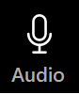



Hospitality
Leader:
Please mute for the service unless invited to offer your voice as part of the service ministry
Have the video camera on or off and turn the volume and brightness up or down on your device if things are too loud 🔉🔊or too bright🔅🔆
Our Cantor acts as our voice, offering the responses, in Bold Text, which we say together
Feel welcome to use the chat and reaction emojis 👍
🙏 Please take care of yourself in this space. 🙏 Come and go as you need
😴 It is great to take rest in this space, so falling asleep is also OK 😴
👂️ Remember, pastoral care is available to all in the community, if you'd like to speak to someone about anything spiritual. ❤️ Visit the help page at the website to reach out 🌐
Our Being Together ethos and safeguarding practices can also be accessed on the website 🫶​
🙌 Come as you are – we are all here together! 🙌
Notes:
Used Lent 2022

Slide 3
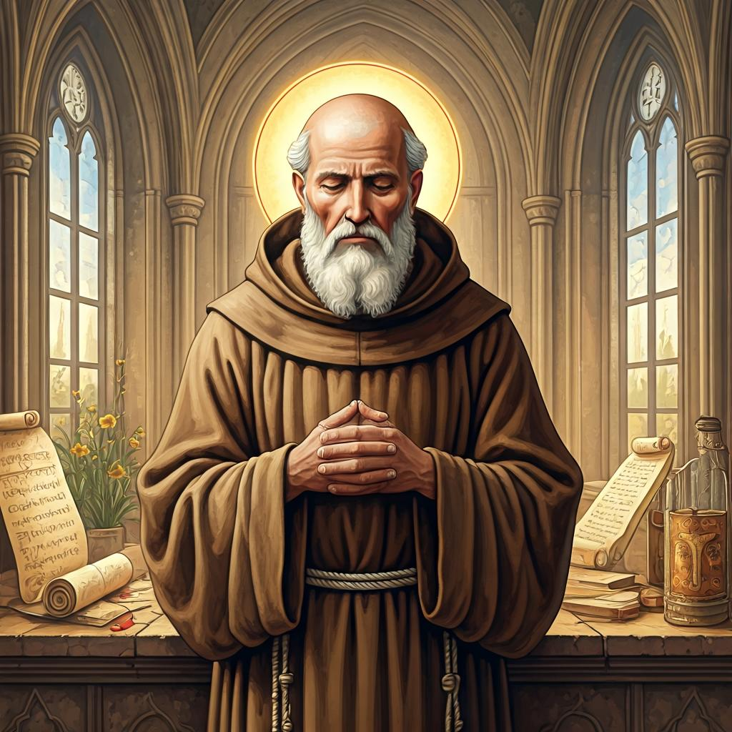
Leader: Our Holy Hermit Highlights for today
Gildas the Wise was a 6th-century British monk and writer, born into a royal family but formed in monastic life, who became a teacher and founder of churches in Britain and Ireland before settling in Brittany. There he wrote De Excidio Britanniae, a fierce call to repentance addressed to British rulers, and he died at Rhuys on 29 January 570; tradition also links him with a protective hymn known as a Lorica or Breastplate.
To read more about our hermits please click the link​​ in the send out

Slide 4
Invitation
Leader: As we settle into worship let your breath be soft, your mind be still, and your heart be open to the presence of God.
Opening Music: https://www.youtube.com/watch?v=0FI-h3OWr7Y

Slide 5
Leader and Cantor unmute
The Greeting
Leader: The Grace of the lord Jesus Christ, and the
love of God, and the fellowship of the Holy
Spirit, be with you all.
All: And also with you.

Slide 6
Gathering Prayer
Leader:
Father God, we bring before you all our questions,
all our doubts, and all our uncertainties
and offer them to you, along with our praise,
trusting that you hear us and love us.

Slide 7
Gathering Prayer
All:We gather before you, God,
like curious children around a parent’s chair;
eager to listen and to learn,
but also with questions in our hearts and on our minds.
We gather in faith that you, all-knowing God,
will hear us with the patience of a good parent,
for you welcome our curiosity
and are always ready to hear earnest questioning.
Amen.

Slide 8
Sentence
Leader: I invite our Cantor to proclaim the sentence for today.
Cantor: God so loved the world that he gave his only Son, so that everyone who believes in him may not perish but may have eternal life.
John 3.16

Slide 9
Leader: We pray the prayer of approach together
All: We gather before you, God, like curious children around a parent’s chair; eager to listen and to learn,
but also with questions in our hearts and on our minds. We gather in faith that you, all-knowing God,
will hear us with the patience of a good parent,
for you welcome our curiosity
and are always ready to hear earnest questioning.
Amen.

Slide 10
Our First Hymn is
Love will be our Lenten Calling
https://www.youtube.com/watch?v=RLegowSR2nk
We stay on mute
Leader and Cantor mute

Slide 11
The Deacon Introduces Confession​
The Lord comes, bringing to light things now hidden in darkness, and disclosing the purposes of the heart.
​​
Silence may be kept.​..
​
Let us open our hearts and prepare for his coming, confessing our sins in penitence and faith.

Slide 12
All: ​Merciful God, our maker and our judge, ​
we have sinned against you ​in thought, word, and deed, ​and in what we have failed to do: ​
we have not loved you with our whole heart; ​
we have not loved our neighbours as ourselves; ​
we repent, and are sorry for all our sins.​
Father, forgive us. Strengthen us to love and obey you in newness of life; ​through Jesus Christ our Lord. ​Amen.​

Slide 13
Words of Assurance offered by the Deacon
These words of assurance from the First Letter of John declare that:
If anyone sins, we have an advocate with the Father, Jesus Christ the righteous. He is the perfect offering for our sin, and not for ours only, but for the sins of the whole world.
(1 John 2: 1-2)
In this is love, not that we loved God, but that he loved us and sent his Son to be the perfect offering for our sins.
(1 John 4:10)

Slide 14
Collect
Leader: God of mercy, you are full of tenderness and compassion, slow to anger, rich in mercy,
and always ready to forgive: grant us grace to renounce all evil and to cling to Christ, that in every way we may prove to be your loving children; through Jesus Christ our Lord,
who lives and reigns with you and the Holy Spirit,
one God, for ever and ever.
Amen.

Slide 15
≈
The 1st reader unmutes
Leader: I invite the 1st reader to unmute and offer the 1st lesson when ready.
Reader 1: The 1st Reading is from Genesis 12.1-4a
¹ Now the Lord said to Abram, ‘Go from your country and your kindred and your father’s house to the land that I will show you. ² I will make of you a great nation, and I will bless you, and make your name great, so that you will be a blessing. ³ I will bless those who bless you, and the one who curses you I will curse; and in you all the families of the earth shall be blessed.’ ⁴ So Abram went, as the Lord had told him; and Lot went with him. Abram was seventy-five years old when he departed from Haran.
For the word of the Lord. Thanks be to God.​

Slide 16
Leader: We now say the psalm antiphonally, I invite the first reader to lead, and we will all respond with our cantor as our voice.
Psalm 121
¹ I lift up my eyes to the hills:
but where shall I find help?
² My help comes from the Lord:
who has made heaven and earth.
³ He will not suffer your foot to stumble:
and he who watches over you will not sleep.
⁴ Be sure he who has charge of Israel:
will neither slumber nor sleep.
Continue…

Slide 17
⁵ The Lord himself is your keeper:
the Lord is your defence upon your right hand;
⁶ The sun shall not strike you by day:
nor shall the moon by night.
⁷ The Lord will defend you from all evil:
it is he who will guard your life.
⁸ The Lord will defend your going out and your coming in: from this time forward for evermore.

Slide 18
The 2nd reader unmutes
Leader: Thank you, I invite the 2nd reader to unmute and offer the 2nd lesson when ready.
Reader 2: The 2nd Reading is from Romans 4.1-5; 4.13-17
¹ What then are we to say was gained by Abraham, our ancestor according to the flesh? ² For if Abraham was justified by works, he has something to boast about, but not before God. ³ For what does the scripture say? ‘Abraham believed God, and it was reckoned to him as righteousness.’ ⁴ Now to one who works, wages are not reckoned as a gift but as something due.
Continue…

Slide 19
⁵ But to one who without works trusts him who justifies the ungodly, such faith is reckoned as righteousness. ¹³ For the promise that he would inherit the world did not come to Abraham or to his descendants through the law but through the righteousness of faith. ¹⁴ If it is the adherents of the law who are to be the heirs, faith is null and the promise is void. ¹⁵ For the law brings wrath; but where there is no law, neither is there violation.
Continue…

Slide 20
¹⁶ For this reason it depends on faith, in order that the promise may rest on grace and be guaranteed to all his descendants, not only to the adherents of the law but also to those who share the faith of Abraham(for he is the father of all of us, ¹⁷ as it is written, ‘I have made you the father of many nations’)—in the presence of the God in whom he believed, who gives life to the dead and calls into existence the things that do not exist.
For the word of the Lord. Thanks be to God.

Slide 21
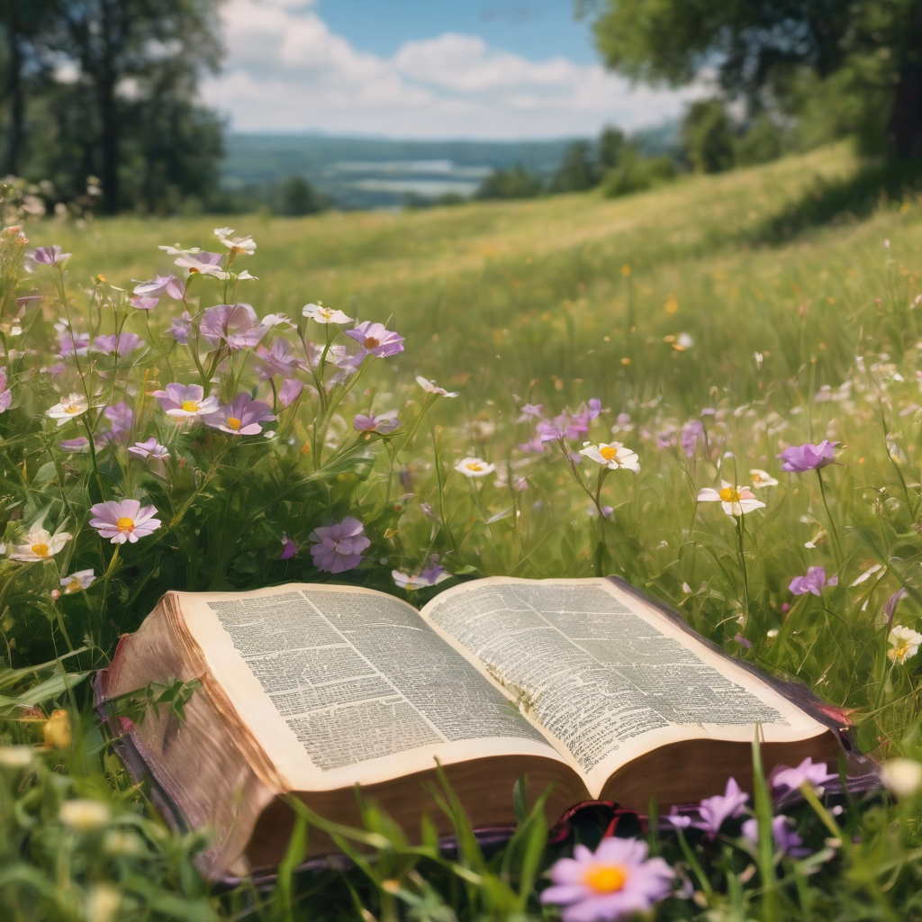
We pause before
​the Gospel ​​

Slide 22
Leader: The Gospel of our Lord Jesus Christ according to St John Chapter 3 beginning at the 1st verse
All: Glory to you Lord Jesus Christ.
¹ Now there was a Pharisee named Nicodemus, a leader of the Jews. ² He came to Jesus by night and said to him, ‘Rabbi, we know that you are a teacher who has come from God; for no one can do these signs that you do apart from the presence of God.’ ³ Jesus answered him, ‘Very truly, I tell you, no one can see the kingdom of God without being born from above.’ ⁴ Nicodemus said to him, ‘How can anyone be born after having grown old? Can one enter a second time into the mother’s womb and be born?’
Continue…

Slide 23
⁵ Jesus answered, ‘Very truly, I tell you, no one can enter the kingdom of God without being born of water and Spirit. ⁶ What is born of the flesh is flesh, and what is born of the Spirit is spirit. ⁷ Do not be astonished that I said to you, “You must be born from above.” ⁸ The wind blows where it chooses, and you hear the sound of it, but you do not know where it comes from or where it goes. So it is with everyone who is born of the Spirit.’ ⁹ Nicodemus said to him, ‘How can these things be?’ ¹⁰ Jesus answered him, ‘Are you a teacher of Israel, and yet you do not understand these things?
Continue…

Slide 24
¹¹ ‘Very truly, I tell you, we speak of what we know and testify to what we have seen; yet you do not receive our testimony. ¹² If I have told you about earthly things and you do not believe, how can you believe if I tell you about heavenly things? ¹³ No one has ascended into heaven except the one who descended from heaven, the Son of Man. ¹⁴ And just as Moses lifted up the serpent in the wilderness, so must the Son of Man be lifted up, ¹⁵ that whoever believes in him may have eternal life.
Continue…

Slide 25
¹⁶ ‘For God so loved the world that he gave his only Son, so that everyone who believes in him may not perish but may have eternal life. ¹⁷ ‘Indeed, God did not send the Son into the world to condemn the world, but in order that the world might be saved through him
For the word of the Lord. Thanks be to God.

Slide 26
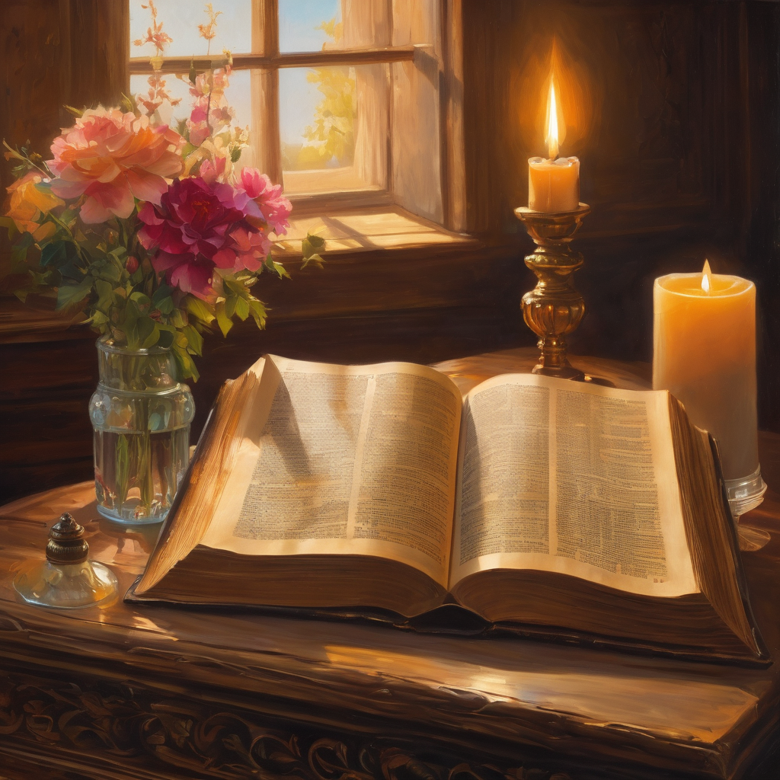
We pause
after ​the Gospel ​​

Slide 27
Leader: The Sermon is recorded to YouTube for sharing later.
Only the preacher's video and audio will be recorded.
The chat and other participants' feeds remain out of sight of the recording.
Leader and Cantor mute
Broadcaster exits screenshare
Preacher unmutes
Zoom buttons ”pins” preacher’s screen + selects “record to the cloud”
Sermon

Slide 28
Leader unmutes
Our next Hymn is
Take Up Your Cross, and Follow Me
https://www.youtube.com/watch?v=QOHByr5J5J8
We stay on mute
Leader mutes

Slide 29
The Leader and Cantor unmute
The Greeting of Peace
Leader: We are the body of Christ
All: God’s Spirit is with us
Leader: The peace of the Lord be always with you.
All: And also with you.
Leader: A sign of peace may be exchanged
You may like to type 'Peace' into the chat, use the 'raise hand’ or other reaction buttons, or just simply wave via the screen with your video turned on
(Broadcaster exits shared screen for a few moments for the exchange of peace)

Slide 30
Prayer of Thanksgiving before Intercessions
Leader: As we enter prayer, I invite the second reader to unmute to lead our intercessions which follow the prayer of thanksgiving. Please feel free to change your body position as you need.
Leader: Lord Jesus, we thank you for your welcome to Nicodemus when he sought you by night. We are grateful that we can come to you at any hour; you are only a prayer away. We give thanks that we can ask about what is on our minds. We praise you for being available to us at all times and in all places; that you help us to come to knowledge and understanding. Amen.

Slide 31
Intercessions
Reader 2: We pray for creation and communities we share our lives with. We pause for a few moments to name either in our hearts, or out loud, or in the chat, those environments and communities we bring to the Lord in prayer.
PAUSE…
We entrust to you the community of Holy Hermits Online and our ministry partners:
Prosper the work of our hands and show us the way to your new creation.
Creator God, Hear our prayer.
St John's Cathedral Brisbane The Anglican Diocese of Southern Queensland St Gabriel’s, Carindale Benedictus Contemplative Church, Canberra Anglican Focus and Tithe.ly

Slide 32
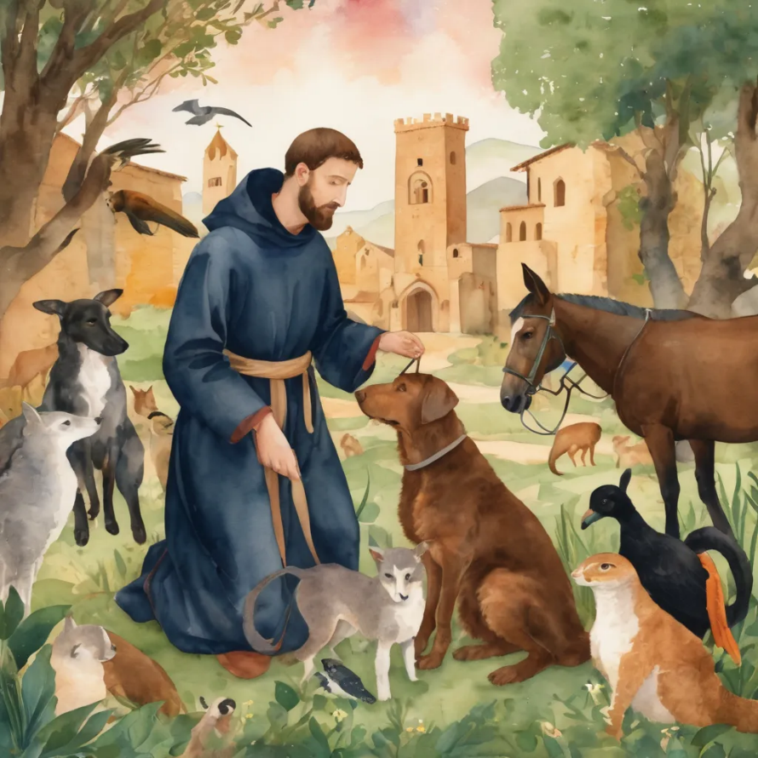
Reader 2: Loving Creator, we entrust to you all animals, especially those who are sick, anxious, ageing, lost, at risk, lonely, sad, hungry, in pain, homeless, abused, living in fear, encountering violence of any kind, in need of comfort, rehabilitation or transformation.
We invite your loving compassion for:
We name in our hearts, out loud or in the chat,
the animals we bring to the Lord in prayer. PAUSE…
Jasmine, ​
Leese(y), ​
Sid, Toots & Lulu​
Polly and Suki​
Fred, George & Percy​
Koshka ​
Jax
Lambert ​​
Kala, Nigel & Little One ​​
Toby​​
Taco​​
Paddy ​​
Rosie​

Slide 33
Reader 2: Eternal Trinity of Love, we uphold to you the people we love and carry cares for:
We name in our hearts, out loud or in the chat, those we bring to the Lord in prayer. PAUSE… We entrust to you those who have died, those who have died peacefully and those who have died tragically, The old and the young. Receive them into your Kingdom. Lord in your mercy, Hear our prayers. Amen.
Kerry, Les & Jake Julie, Ray, Tracey & Shane Mark, Desley & Bob ​​ Rachel, Mervyn & Gillian ​​Rev'd Shane & Janette​​ Alecia, Martin & Aidan​​ Steven & Vanessa | Barry​​ Dr Julie ​​ Ruth​​ Phil​ May Susan Tanya​ Craig Neva​ | Bill & Marjorie​​ Aaron & Andrea Dilys & Tony, Paul & Darhon Judy & Mary​​ Bob & Di​ Pat & Julie Miriam Gayanne | Kirsten, Greg, Daphne & Beau Alan & Gaylene​ Jess & Leah ​​ Bonnie & girls Liz’s Godchildren Barry & Gwen Matthew & Nicholas​

Slide 34
Pray Daily Cycle of Prayer
Leader: Loving God, joining with the Church in our cycle of prayer, we ask your blessings on:
• The Nippon Sei Ko Kai
• The ongoing work of peace-making in Sudan & South Sudan
• The Anglican Church of Australia: The Primate - †Mark; The General
Secretary - Anne; The General Synod and the Standing Committee
• The Parish of Sandgate Northpoint: Ann Shepperson – locum, George Henry, Jonathan
• Diocesan Reconciliation Action Plan Co-ordinator: Sandra
• Anglican Schools Office, Church House: A/g Executive Director – Geoff Newton, Executive Director & staff

Slide 35
Leader: Commitment prayer for the week:
In Times of Natural Disasters
All things look to you, O Lord, to give them their food in due season: look in mercy on your people, and hear our prayer for those whose lives and possessions have been affected by natural disaster. ​We ask that all our first responders, volunteers and emergency service workers be given strength and care, rest and recuperation. ​We uphold the vulnerable ones, children and animals, people living rough and in financial distress; that they be given courage and the appropriate support. ​Please empower community groups and organisations as they step up. Encourage neighbours as they look out for one another.
Continue…

Slide 36
Inspire communities to support and resource animal organisations as they offer sanctuary and care for displaced animals—domestic, farm and wild. ​Give courage to all who work in ongoing trauma recovery; support workers, doctors, nurses, social workers, psychologists, veterinarians, counselling services, chaplains, clergy and local ministers. May they be enabled to sustain good self-care practices, access resources, find strength and resilience, peace and rest.​May all who suffer survivor guilt, be compassionate towards themselves and find grace in you. Holy Spirit please gently lead their energy into prayer, loving service and gratitude, so they can experience and share peace.
Continue…

Slide 37
We entrust the rebuilding efforts into your care Lord. May the resources needed become available, the trades people offering their skills be honest and diligent. ​We hold before you Lord, local council and governments especially politicians and leaders as they represent people and places. Give them inspiration, wisdom and discernment. ​In your mercy restore your creation and heal our lands, air and waterways, regenerate all that has been destroyed and inspire people to help with that new growth and restoration. ​So guide and bless your people, that we may enjoy the fruits of the earth and give you thanks with grateful hearts, through our Lord Jesus Christ. Amen.​
Adapted from: A Prayer Book for Australia Prayers for Various Occasions—Prayer #12 p.205. At HHO Weekly Worship fellowship 7th January 2024.

Slide 38
Leader: Let us pray together the prayer which Jesus gave us saying:
All: Our Father in heaven,
hallowed be your name,
your kingdom come, your will be done,
on earth as in heaven.
Give us today our daily bread.
Forgive us our sins
as we forgive those who sin against us.
Save us from the time of trial
and deliver us from evil.
For the kingdom, the power,
and the glory are yours
now and for ever.
Amen.

Slide 39
Devotions

Slide 40
Hermit Wisdom

Slide 41
Leader: Wisdom from Gildas the Wise
“You are drunk with the practicing of constant sins, and shaken by the waves of accumulated crimes that incessantly rush upon you; seek then, as though you had suffered shipwreck, with all the striving of your mind, for the single plank of penitence that can carry you to the land of the living, so that the fury of the Lord may be turned away from you. For in His mercy He said: 'I do not desire the death of a sinner, but that he may turn and live.”

Slide 42
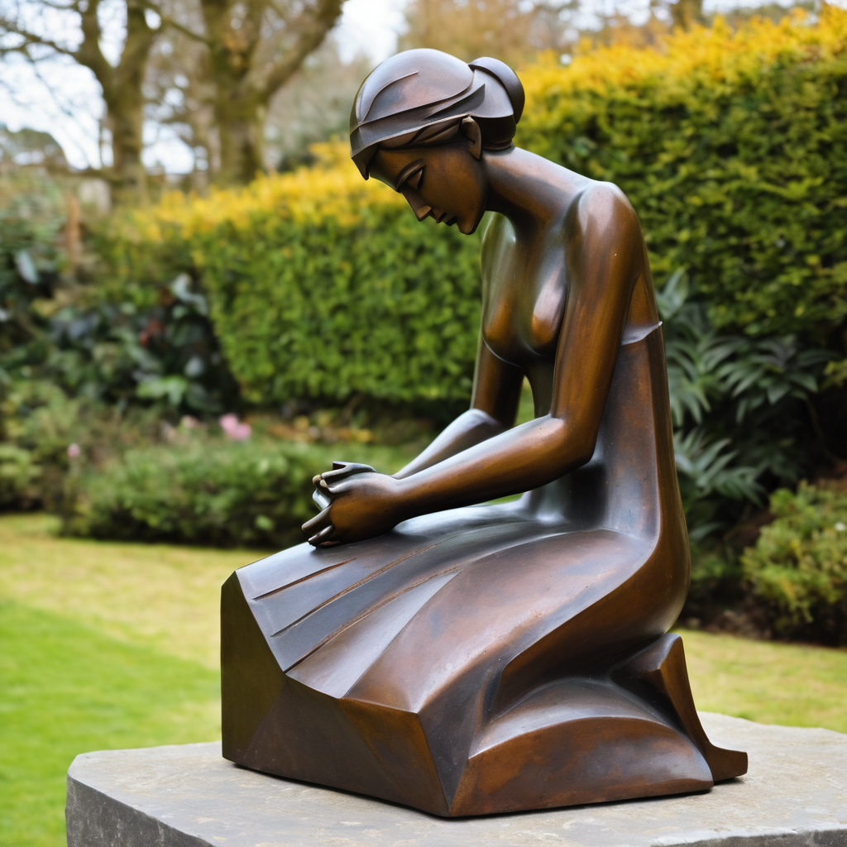
Leader: ​As we enter a few minutes of silence together, you are invited to pray this prayer of adoration and/or spend this time in contemplation. ​
The Spiritual Communion prayer follows
on the next slide. Let us be still.
Leader and Cantor Mute
​
Dear God,
we offer up to you all our questions,
and ask that we would receive from you the answers that we need for the next step of our journey,
according to your will.
In Jesus’ name we pray.
Amen

Slide 43
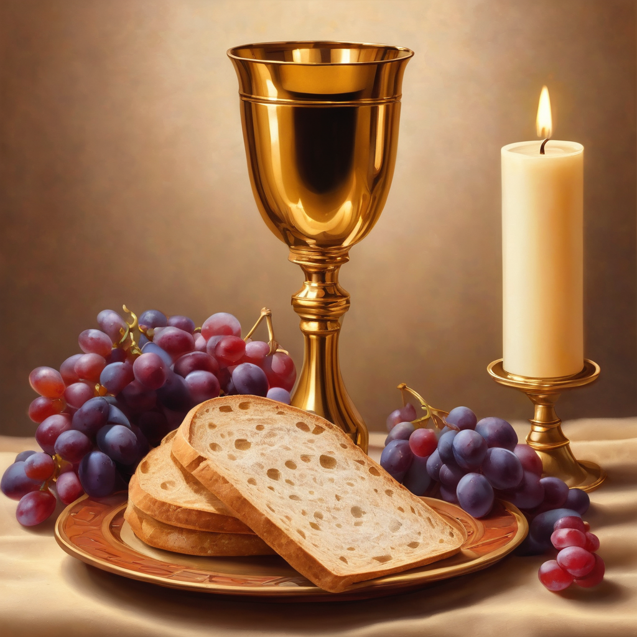
Oh, my Lord Jesus I turn to you
present at the Altar and in the
Tabernacle. I believe that you are
present in the Holy Sacrament of your
most Sacred Body and Blood. I love you
above all things and I desire to receive
you into my Soul. I cannot at this
moment receive you Sacramentally in
Holy Communion. Come spiritually into
my heart. Purify it, Sanctify it. Render
my heart like your own heart.
I embrace you as if you were already
there and unite myself wholly with
you. Never permit me to be separated
from you. Lord, I am not worthy to
receive you, but only say the word and I
shall be healed. Amen
Making a
Spiritual Communion
(Prayed in silence)

Slide 44
Leader unmutes
Our final song is
It Is No Secret
https://www.youtube.com/watch?v=qEilNm1VUw4
​We stay on mute
Leader and Cantor mute

Slide 45
Leader and cantor unmute
Sending Prayer
Leader: We pray our sending prayer together.
All: God of our journey and God of our questions,
thank you for being with us each step of our journey,
and that you hear each question we ask – both those we ask aloud and those we ask silently in our hearts. Be with us as we journey on and keep asking questions.
Amen

Slide 46
The Benediction
Leader: Let us all invite God’s blessings together,
All: May the Lord bless us and keep us.
May the Lord’s face shine upon us and be gracious to us. May the Lord’s countenance be lifted upon us, and bring us peace. Amen

Slide 47
Notices
Companion Animal Ministry workshop today @ 11:00, everyone is welcome
Our Lent study with the Cathedral continues Wednesday @ 7:30pm. Contact Re’d Jess if you would like to sign up (jgrant@stjohnscathedral.com.au).
Prayer and Praise with Our Animal Friends, Thursday 12th March @ 6pm
See HHO Events page for further upcoming events HHO Events

Slide 48

Offerings: Thank you for your regular gifts to this ministry
Offerings are most welcome via
The HHO App
Direct Debit
International Direct Debit
Please consider a one-off donation
or leaving a legacy in your Will
For further information go to HHO give page https://holyhermits.com.au/give

Slide 49
Serving next week
Sunday 8th March
9:00 am AEST
Service Prep: Kristine | Chat Host: Rachel | First Reader: Phil
Music: Wiggles 🐶 | Welcomer: Julie | Second Reader: Helen
Proof-reader: Viki | Priest: N/A | Preacher: Flashback
Broadcaster: Lauren | Deacon: Lauren | Fellowship: Julie
Backup Broadcaster: Kieron | Leader: Jeremy | Safety Officer: Leonie
Zoom Buttons: Kieron | Cantor: Roselyn | Attendance: Rachel
Thank you for your ministry gifts
New Servers always welcome!
Please email Rev’d Lauren to get involved
holyhermits@anglicanchurchsq.org.au

Slide 50
Leader: I invite everyone to unmute for the Dismissal
Leader: Go in peace to love and serve the Lord.
All: In the name of Christ, Amen.

Slide 51
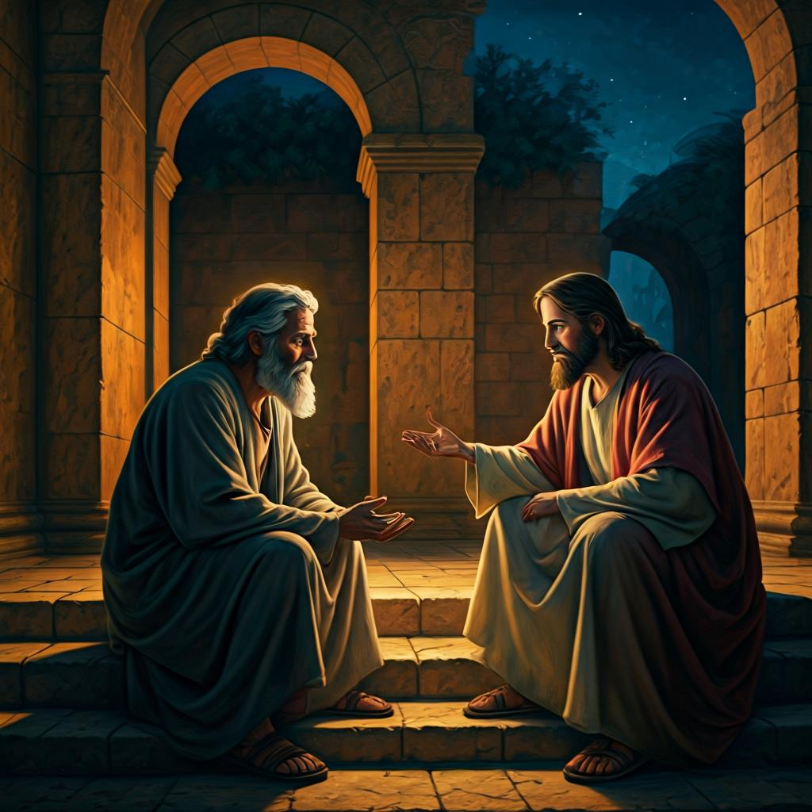
Fellowship time
Thank you, Leonie for leading Fellowship
Please feel welcome to linger or pop a message in the chat and head off when you are ready.​
Extra resources developed
by Roots on the Web
Artwork by Padlet

