Slide 1
Welcome to Holy Hermits Online Worship
Easter Day
Resurrection Party!
Service Prep: Leonie | Chat Host: Rachel | First Reader: Phil
Music: Wiggles 🐶 | Welcomer: Leonie | Second Reader: Viki
Proof-reader: Viki | Priest: N/A | Preacher: Lauren
Broadcaster: Barry | Deacon: Lauren | Fellowship: Julie
Backup Broadcaster: Lauren | Leader: Jeremy | Safety Officer:
Zoom Buttons: Lauren | Cantor: Roselyn | Attendance: Rachel
Prep: 28/03/2026 Proofed: 29/03/2026

Slide 2






Hospitality
Leader:
Please mute for the service unless invited to offer your voice as part of the service ministry
Have the video camera on or off and turn the volume and brightness up or down on your device if things are too loud 🔉🔊or too bright🔅🔆
Our Cantor acts as our voice, offering the responses, in Bold Text, which we say together
Feel welcome to use the chat and reaction emojis 👍
🙏 Please take care of yourself in this space. 🙏 Come and go as you need
😴 It is great to take rest in this space, so falling asleep is also OK 😴
👂️ Remember, pastoral care is available to all in the community, if you'd like to speak to someone about anything spiritual. ❤️ Visit the help page at the website to reach out 🌐
Our Being Together ethos and safeguarding practices can also be accessed on the website 🫶​
🙌 Come as you are – we are all here together! 🙌
Notes:
Used Lent 2022

Slide 3
Invitation
Leader: We come into worship with Haec Dies: Confitemini (Easter Sunday Gradual) - a Resurrection Gregorian Chant. Let your breath be soft, your mind be still, and your heart be open to the presence of God.
https://youtu.be/YI1HEbZI1cc?si=ByfExwQQR7jKgN6y

Slide 4
Leader and Cantor unmute
The Greeting
Leader: Christ has risen, Alleluia!
All: Christ is risen indeed, Alleluia!

Slide 5
Gathering Prayer
Leader: On this glorious Easter Day,
let us celebrate once again that the tomb is empty, that Jesus is alive and that,
even in dramatic scenes of noise and confusion,
he meets and greets us with words of comfort and joy.

Slide 6
Gathering Prayer
All: ​Risen Lord Jesus,
we praise you that you are alive,
that you are here with us now.
We worship you as your friends did on the very first Easter Day,
and we pray that you will renew our faith and make us strong,
so that we may tell others your good news
and bring your peace to the world. Amen.

Slide 7
Sentence
Leader: I invite our Cantor to proclaim the sentence for today.
Cantor: Christ our Passover has been sacrificed for us; therefore let us keep the feast.
1 Corinthians 5:7

Slide 8
Prayer of Approach
Leader: We pray the prayer of approach together
All: Risen Lord Jesus, breaking forth from the tomb,
breaking the power of death,
breaking new ground where faith will flourish –
we greet you with joy and jubilation
on this Easter Day! Christ is risen!
He is risen indeed! Alleluia! Amen.

Slide 9
Our First Hymn is
The Day of Resurrection
https://www.youtube.com/watch?v=49hPB6NTVEE
We stay on mute
Leader and Cantor mute

Slide 10
Prayer of Adoration
All: Almighty God, with new life breaking through the soil,
and the sounds of Spring all around,
we celebrate your Son
laying the foundations of our faith
by his dying and rising again, defeating death.
We bring to you our adoration,
groundbreaking God, who shakes and shapes the world!
Amen.

Slide 11
The Deacon Introduces Confession​
Christ our Passover Lamb has been offered for us, therefore we come to celebrate the festival.
​​
Silence may be kept.​..
​
Let us confess our sins in penitence and faith, with a sincere and a true heart.

Slide 12
All: ​Merciful God, our maker and our judge, ​
we have sinned against you ​in thought, word, and deed, ​
and in what we have failed to do: ​
we have not loved you with our whole heart; ​
we have not loved our neighbours as ourselves; ​
we repent, and are sorry for all our sins.​
Father, forgive us. Strengthen us to love and obey you
in newness of life; ​through Jesus Christ our Lord. ​
Amen.​

Slide 13
Words of Assurance offered by the Deacon
These words of assurance from the First Letter of John declare that:
If anyone sins, we have an advocate with the Father, Jesus Christ the righteous. He is the perfect offering for our sin, and not for ours only, but for the sins of the whole world.
(1 John 2: 1-2)
In this is love, not that we loved God, but that he loved us and sent his Son to be the perfect offering for our sins.
(1 John 4:10)

Slide 14
The Gloria​
(to be sung every Sunday during the Season of Easter)
Leader: We now sing the Gloria together
https://www.youtube.com/watch?v=wCgGyxilhkY
Leader Mutes

Slide 15
Collect
Leader: Glorious Lord of life, by the mighty resurrection of your Son you overcame the old order of sin and death to make all things new in him: grant that we, who celebrate with joy
Christ’s rising from the dead may be raised from the death of sin to the life of righteousness;
through him who lives and reigns with you and the Holy Spirit, one God, now and for ever.
Amen.

Slide 16
The 1st reader unmutes
Leader: I invite the 1st reader to unmute and offer the 1st lesson when ready.
Reader 1: The 1st Reading is from Acts 10.34-43
³⁴ Then Peter began to speak to them: ‘I truly understand that God shows no partiality, ³⁵ but in every nation anyone who fears him and does what is right is acceptable to him. ³⁶ You know the message he sent to the people of Israel, preaching peace by Jesus Christ—he is Lord of all.
Continue…

Slide 17
³⁷ That message spread throughout Judea, beginning in Galilee after the baptism that John announced: ³⁸ how God anointed Jesus of Nazareth with the Holy Spirit and with power; how he went about doing good and healing all who were oppressed by the devil, for God was with him. ³⁹ We are witnesses to all that he did both in Judea and in Jerusalem. They put him to death by hanging him on a tree;⁴⁰ but God raised him on the third day and allowed him to appear,
Continue…

Slide 18
⁴¹ not to all the people but to us who were chosen by God as witnesses, and who ate and drank with him after he rose from the dead. ⁴² He commanded us to preach to the people and to testify that he is the one ordained by God as judge of the living and the dead. ⁴³ All the prophets testify about him that everyone who believes in him receives forgiveness of sins through his name.’
For the word of the Lord. Thanks be to God.​

Slide 19
Leader: We now say the psalm antiphonally, I invite the first reader to lead, and we will all respond with our cantor as our voice.
Psalm 118.1-2; 118.14-24
¹ O give thanks to the Lord, for he is good:
his mercy endures for ever.
² Let Israel now proclaim:
that his mercy endures for ever.
¹⁴ The Lord is my strength and my song:
and has become my salvation.
Continue…

Slide 20
¹⁵ The sounds of joy and deliverance:
are in the tents of the righteous.
¹⁶ The right hand of the Lord does mighty things:
the right hand of the Lord raises up.
¹⁷ I shall not die but live:
and proclaim the works of the Lord.
¹⁸ The Lord has disciplined me hard:
but he has not given me over to death.
Continue…

Slide 21
¹⁹ Open me the gates of righteousness:
and I will enter and give thanks to the Lord.
²⁰ This is the gate of the Lord:
the righteous shall enter it.
²¹ I will praise you, for you answered me:
and have become my salvation.
²² The stone that the builders rejected:
has become the head of the corner.
Continue…

Slide 22
²³ This is the Lord’s doing:
and it is marvelous in our eyes.
²⁴ This is the day that the Lord has made:
let us rejoice and be glad in it.

Slide 23
The 2nd reader unmutes
Leader: Thank you, I invite the 2nd reader to unmute and offer the 2nd lesson when ready.
Reader 2: The 2nd Reading is from Colossians 3.1-4
¹ So if you have been raised with Christ, seek the things that are above, where Christ is, seated at the right hand of God. ² Set your minds on things that are above, not on things that are on earth, ³ for you have died, and your life is hidden with Christ in God. ⁴ When Christ who is your life is revealed, then you also will be revealed with him in glory.
For the word of the Lord. Thanks be to God.

Slide 24

We pause before
​the Gospel ​​

Slide 25
Deacon: The Gospel of our Lord Jesus Christ according to St Matthew Chapter 28 beginning at the 1st verse
All: Glory to you Lord Jesus Christ.
¹ After the sabbath, as the first day of the week was dawning, Mary Magdalene and the other Mary went to see the tomb. ² And suddenly there was a great earthquake; for an angel of the Lord, descending from heaven, came and rolled back the stone and sat on it. ³ His appearance was like lightning, and his clothing white as snow. ⁴ For fear of him the guards shook and became like dead men.
Continue…

Slide 26
⁵ But the angel said to the women, ‘Do not be afraid; I know that you are looking for Jesus who was crucified. ⁶ He is not here; for he has been raised, as he said. Come, see the place where he lay. ⁷ Then go quickly and tell his disciples, “He has been raised from the dead, and indeed he is going ahead of you to Galilee; there you will see him.” This is my message for you.’ ⁸ So they left the tomb quickly with fear and great joy, and ran to tell his disciples.
Continue…

Slide 27
⁹ Suddenly Jesus met them and said, ‘Greetings!’ And they came to him, took hold of his feet, and worshipped him. ¹⁰ Then Jesus said to them, ‘Do not be afraid; go and tell my brothers to go to Galilee; there they will see me.’
This is the Gospel of the Lord. Praise to you Lord Jesus Christ.

Slide 28
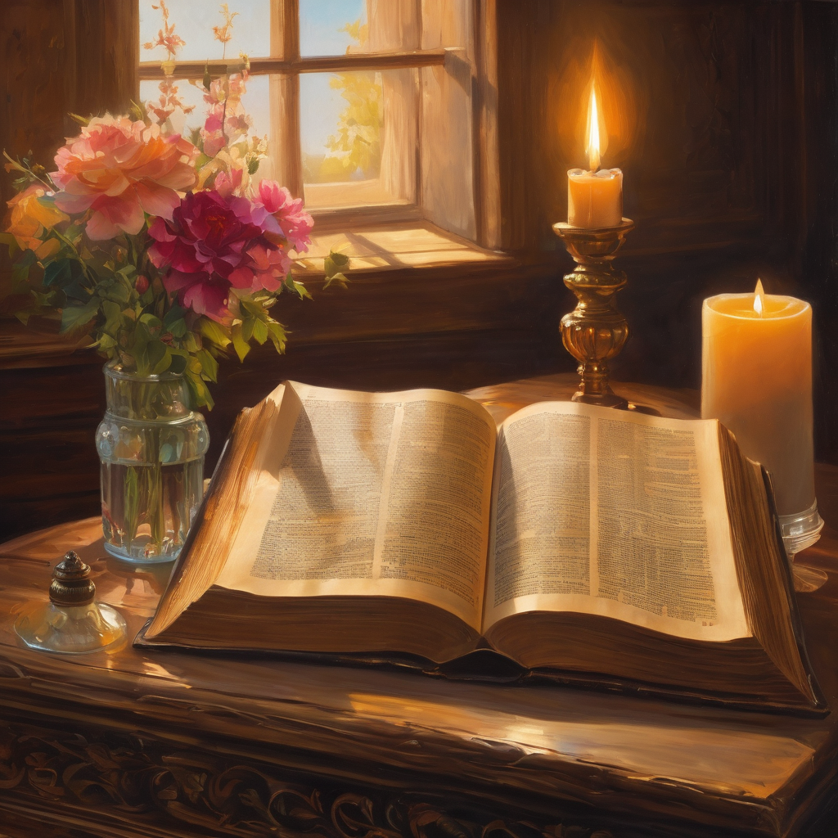
We pause
after ​the Gospel ​​

Slide 29
Leader: The Sermon is recorded to YouTube for sharing later.
Only the preacher's video and audio will be recorded.
The chat and other participants' feeds remain out of sight of the recording.
Leader and Cantor mute
Broadcaster exits screenshare
Preacher unmutes
Zoom buttons ”pins” preacher’s screen + selects “record to the cloud”
Sermon

Slide 30
Leader unmutes
Our next Hymn is
This Is the Day the Lord Has Made
https://www.youtube.com/watch?v=XdjHEHYcF2M
We stay on mute
Leader mutes

Slide 31
The Leader and Cantor unmute
The Greeting of Peace
Leader: We are the body of Christ
All: God’s Spirit is with us
Leader: The peace of the Lord be always with you.
All: And also with you.
Leader: A sign of peace may be exchanged
You may like to type 'Peace' into the chat, use the 'raise hand’ or other reaction buttons, or just simply wave via the screen with your video turned on
(Broadcaster exits shared screen for a few moments for the exchange of peace)

Slide 32
Prayer of Thanksgiving before Intercessions
Leader: As we enter prayer, I invite the second reader to unmute to lead our intercessions which follow the prayer of thanksgiving. Please feel free to change your body position as you need.

Slide 33
Prayer of Thanksgiving before Intercessions
Leader: How can we ever thank you, Lord Jesus, for taking on our frail flesh and suffering in our place, so that in your resurrection we might know the way, the truth and the life. For your remarkable teaching, your faithfulness to God’s plan, your breaking the world free from death and sin, we bring our eternal gratitude. All praise and thanks be to you, risen Lord, for you have rewritten the rules of life and death,
and we are filled with awe and wonder.
All: Amen.

Slide 34
Intercessions
Reader 2: We pray for creation and communities we share our lives with. We pause for a few moments to name either in our hearts, or out loud, or in the chat, those environments and communities we bring to the Lord in prayer.
PAUSE…
We entrust to you the community of Holy Hermits Online and our ministry partners:
Prosper the work of our hands and show us the way to your new creation.
Creator God, Hear our prayer.
St John's Cathedral Brisbane The Anglican Diocese of Southern Queensland St Gabriel’s, Carindale Benedictus Contemplative Church, Canberra Anglican Focus and Tithe.ly

Slide 35
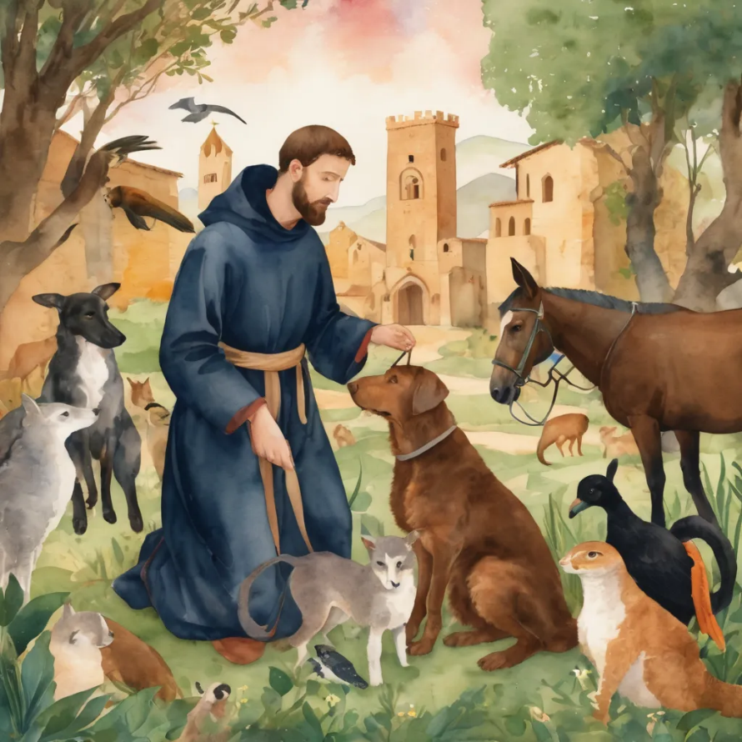
Reader 2: Loving Creator, we entrust to you all animals, especially those who are sick, anxious, ageing, lost, at risk, lonely, sad, hungry, in pain, homeless, abused, living in fear, encountering violence of any kind, in need of comfort, rehabilitation or transformation.
We invite your loving compassion for:
We name in our hearts, out loud or in the chat,
the animals we bring to the Lord in prayer. PAUSE…
Jasmine, ​
Leese(y), ​
Sid, Toots & Lulu​
Polly and Suki​
Fred, George & Percy​
Koshka ​
Jax
Lambert ​​
Kala, Nigel & Little One ​​
Toby​​
Taco​​
Paddy ​​
Rosie​

Slide 36
Reader 2: Eternal Trinity of Love, we uphold to you the people we love and carry cares for:
We name in our hearts, out loud or in the chat, those we bring to the Lord in prayer. PAUSE… We entrust to you those who have died, those who have died peacefully and those who have died tragically, The old and the young. Receive them into your Kingdom. Lord in your mercy, Hear our prayers. Amen.
Kerry, Les & Jake Julie, Ray, Tracey & Shane Mark, Desley & Bob ​​ Rachel, Mervyn & Gillian ​​Rev'd Shane & Janette​​ Alecia, Martin & Aidan​​ Steven & Vanessa Tina | Barry​​ Dr Julie ​​ Ruth​​ Phil​ May Susan Tanya​ Craig Neva​ | Bill & Marjorie​​ Aaron & Andrea Dilys & Tony, Paul & Darhon Judy & Mary​​ Bob & Di​ Pat & Julie Miriam Gayanne | Kirsten, Greg, Daphne & Beau Alan & Gaylene​ Jess & Leah ​​ Bonnie & girls Liz’s Godchildren Barry & Gwen Matthew & Nicholas​

Slide 37
Pray Daily Cycle of Prayer
Leader: Loving God, joining with the Church in our cycle of prayer, we ask your blessings on:
La Iglesia Anglicana de Mexico
The Diocese of Bathurst: †Mark; Clergy and People
The Parish of Parish of Aspley-Albany Creek: Lorraine
Wolston Correctional Centre:
Coomera Anglican College, Coomera: Principal – Patrick; Lay Chaplaincy Team: Dom and Rachael; Chair of School Council – Michael; members of College Council; staff & students

Slide 38
Commitment prayer for the week: Lay Ministry
God of love, pour out your Holy Spirit on our lay ministry at Holy Hermits Online.​​
Bless those who offer their ministry gifts as cantors, readers, prayer writers, Liturgical Assistants, lay leaders, service prep team members, broadcasters, proof-readers, welcomers, tech supporters and helpers in any way. We pray each one feels encouraged to continue serving you.​​

Slide 39
Commitment prayer for the week: Lay Ministry
Give courage to those who hear your voice and offer their ministry gifts so that they too can serve you in the future.​​ Thank you for your rich blessings on our community.​​
In Jesus' name we pray. ​
Amen.​

Slide 40
Leader: Let us pray together the prayer which Jesus gave us saying:
All: Our Father in heaven, hallowed be your name,
your kingdom come, your will be done, on earth as in heaven.
Give us today our daily bread.
Forgive us our sins
as we forgive those who sin against us.
Save us from the time of trial and deliver us from evil.
For the kingdom, the power, and the glory are yours
now and for ever.
Amen.

Slide 41
Devotions

Slide 42
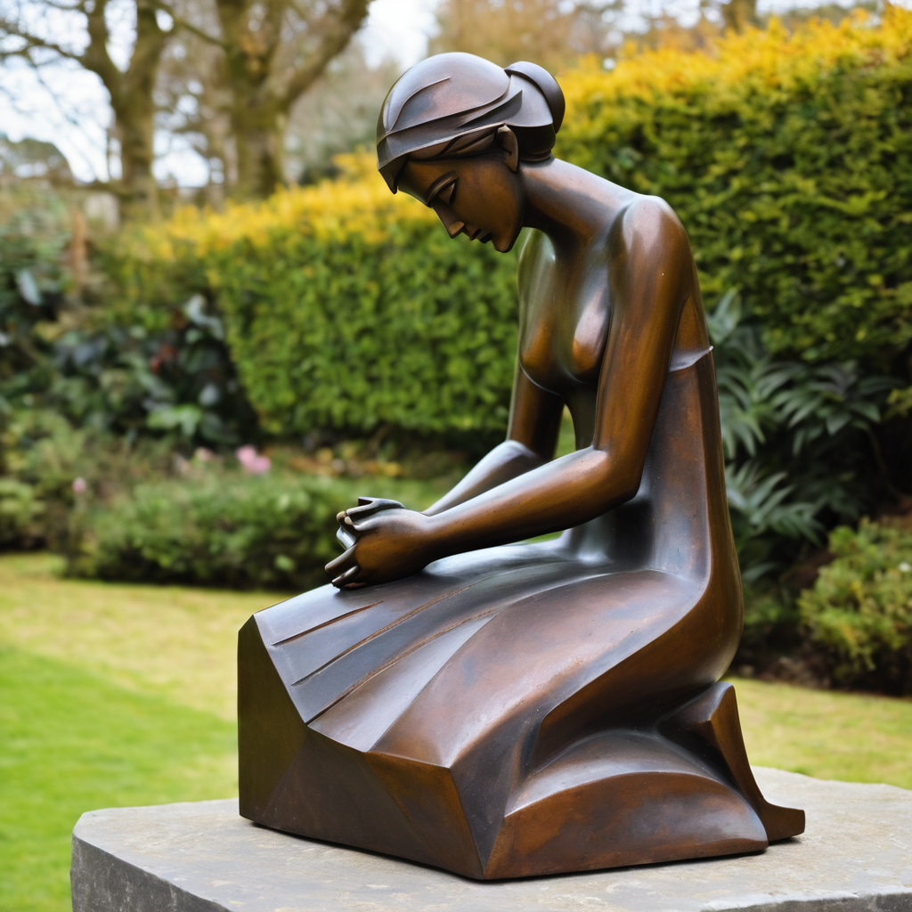
​
Leader: ​As we enter a few minutes of silence together, you are invited to pray this prayer of adoration and/or spend this time in contemplation. ​
The Spiritual Communion prayer follows on the next slide.
Let us be still.
Leader and Cantor Mute.

Slide 43
Dear Lord,
when things happen that make us scared:
help us to know you are with us;
help us to hear you saying
‘Do not be afraid’;
help us to remember that on Easter Day you turned fear to joy;
and help us to share this good news with others.
Amen.
​

Slide 44
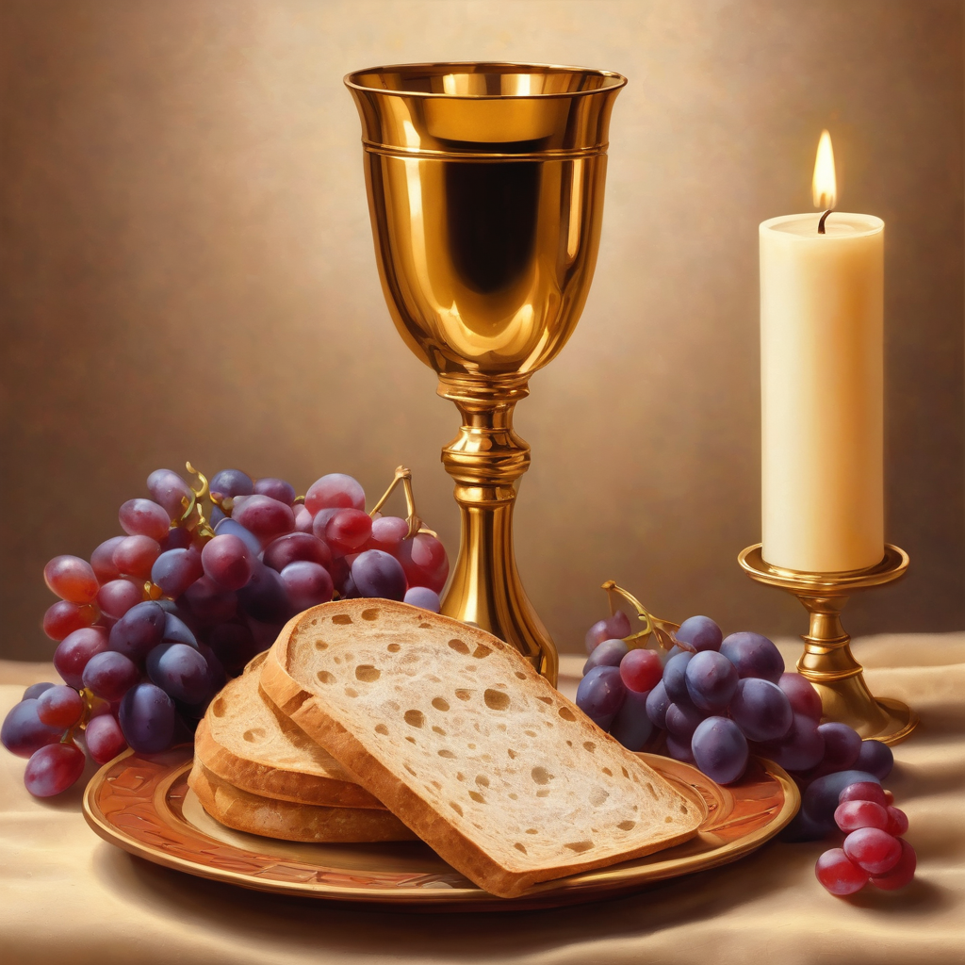
Oh, my Lord Jesus I turn to you
present at the Altar and in the
Tabernacle. I believe that you are
present in the Holy Sacrament of your
most Sacred Body and Blood. I love you
above all things and I desire to receive
you into my Soul. I cannot at this
moment receive you Sacramentally in
Holy Communion. Come spiritually into
my heart. Purify it, Sanctify it. Render
my heart like your own heart.
I embrace you as if you were already
there and unite myself wholly with
you. Never permit me to be separated
from you. Lord, I am not worthy to
receive you, but only say the word and I
shall be healed. Amen
Making a
Spiritual Communion
(Prayed in silence)

Slide 45
Leader unmutes
Our final song is
Risen
https://www.youtube.com/watch?v=0GSt_cAzkVY
​We stay on mute
Leader and Cantor mute

Slide 46
Leader and cantor unmute
Sending Prayer
Leader: We pray our sending prayer together.
All: Thank you, Lord, for this wonderful, hopeful day.
Thank you that you are alive and with us
in all the celebrations and challenges of life.
Go with us now to enjoy our celebrations
and face any challenges ahead. May we share your good news and blessing with all those we meet this week.
Amen.

Slide 47
The Benediction
Leader: Let us all invite God’s blessings together,
All: May the Lord bless us and keep us.
May the Lord’s face shine upon us and be gracious to us.
May the Lord’s countenance be lifted upon us,
and bring us peace. Amen

Slide 48
Notices
Happy Easter everyone! 🐣✝️ Please feel free to bring along an ethical egg to fellowship as we continue to celebrate Easter together.
Our Wednesday study is on a short break, after the conclusion of the Lenten study.
See HHO Events page for further upcoming events HHO Events

Slide 49

Leader: Thank you for your regular gifts to this ministry. Offerings are most welcome via:
The HHO App
Direct Debit
International Direct Debit
Please consider a one-off donation
or leaving a legacy in your Will
For further information go to HHO give page
https://holyhermits.com.au/give

Slide 50
Serving next week
12th April
9:00 am AEST
Service Prep: Lauren | Chat Host: Viki | First Reader: Bob
Music: Lauren | Welcomer: Julie | Second Reader: Liz
Proof-reader: Chris | Priest: N/A | Preacher: Lauren
Broadcaster: Lauren | Deacon: Lauren | Fellowship: Lauren
Backup Broadcaster: Barry | Leader: Lauren | Safety Officer: Chris
Zoom Buttons: Barry | Cantor: Kieron | Attendance: Viki
Thank you for your ministry gifts
New Servers always welcome!
Please email Rev’d Lauren to get involved
holyhermits@anglicanchurchsq.org.au

Slide 51
The Dismissal
Leader: I invite everyone to unmute for the Dismissal
Leader: Go in peace to love and serve the Lord.
All: In the name of Christ, Amen.

Slide 52
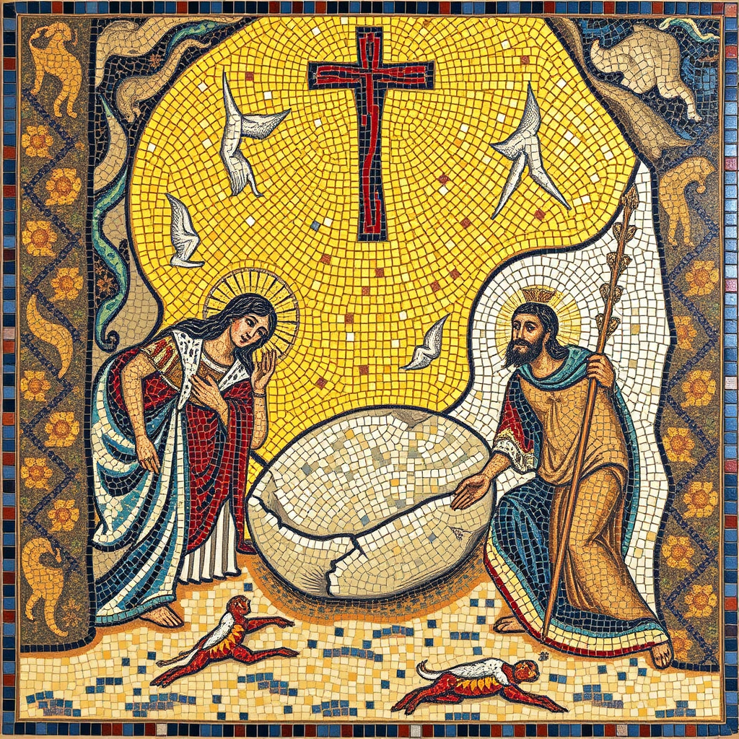
Fellowship time
Thank you Julie for leading Fellowship
Please feel welcome to linger or pop a message in the chat and head off when you are ready.​
Extra resources developed
by Roots on the Web
Artwork by Padlet

