Slide 1
Welcome to Holy Hermits Online Worship
13th Sunday after Pentecost
Today we are remembering
Holy Hermit Sergius of Radonezh
Service Prep: Lauren | Chat Host: Rachel | First Reader: Bob
Music: Lauren | Welcomer: Chris | Second Reader: Helen
Proof-reader: Kris | Priest: N/A | Preacher: Flashback
Broadcaster: Barry | Deacon: N/A | Fellowship: Julie
Backup Broadcaster: Paul | Leader: Julie | Safety Officer: Rachel
Zoom Buttons: Rachel | Cantor: Vanessa | Attendance: Rachel

Slide 2


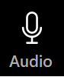



Hospitality
Leader:
Please mute for the service unless invited to offer your voice as part of the service ministry
Have the video camera on or off and turn the volume and brightness up or down on your device if things are too loud 🔉🔊or too bright🔅🔆
Our Cantor acts as our voice, offering the responses, in Bold Text, which we say together
Feel welcome to use the chat and reaction emojis 👍
🙏 Please take care of yourself in this space. 🙏 Come and go as you need
😴 It is great to take rest in this space, so falling asleep is also OK 😴
👂️ Remember, pastoral care is available to all in the community, if you'd like to speak to someone about anything spiritual. ❤️ Visit the help page at the website to reach out 🌐
Our Being Together ethos and safeguarding practices can also be accessed on the website 🫶​
🙌 Come as you are – we are all here together! 🙌
Notes:
Used Lent 2022

Slide 3
Leader: Our Holy Hermit today is Sergius of Radonezh
Born Bartholomew in 1314, Sergius of Radonezh exchanged noble beginnings for poverty, silence, and prayer. After his parents’ death, he withdrew into the forest, where he built a cell and chapel and lived so gently that even wild animals trusted him—a bear famously shared his daily bread. Tonsured as Sergius, he soon drew seekers to his holiness, and his wilderness retreat became the Holy Trinity Monastery.

Slide 4
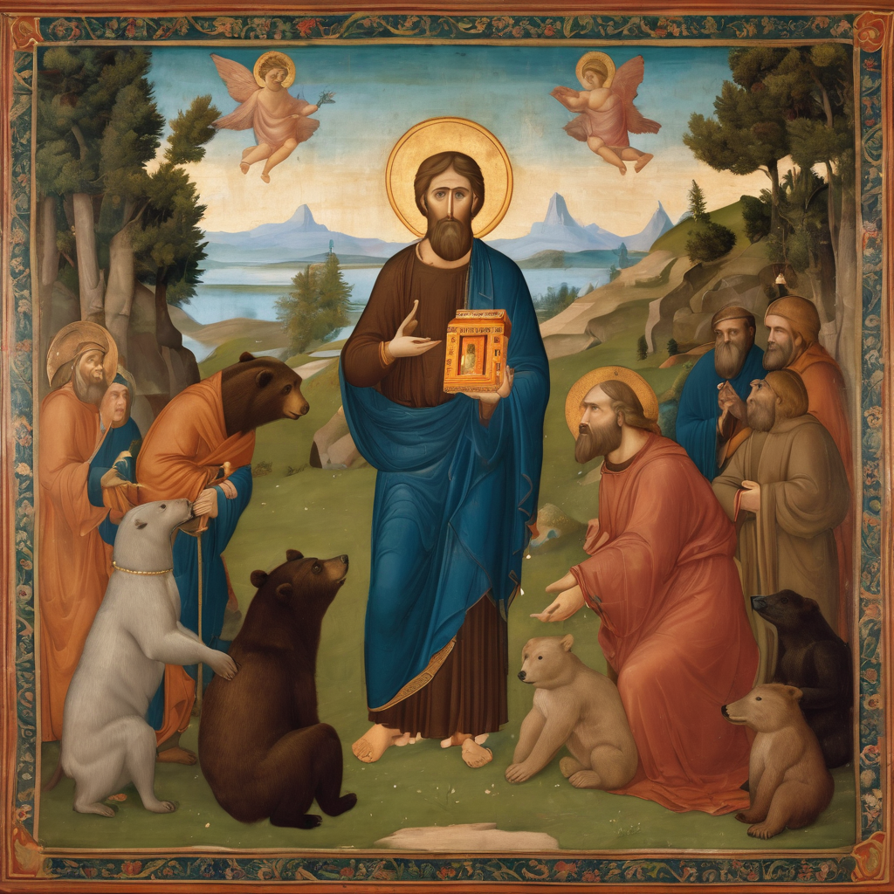
From there, he shaped Russian monastic life, sending disciples across the land to found new communities. Though princes sought his counsel and honors were offered, Sergius chose humility, dying in peace in 1392.
To read more about our hermits click the link​​ in the send out

Slide 5
Invitation
Leader: As we come into worship let’s take a few deep breaths,
Let go of anything that isn’t serving us,
And become aware of God’s presence here with us.
Opening Music: https://www.youtube.com/watch?v=rfbzUdlw4N0

Slide 6
Leader and Cantor unmute
The Greeting
Leader:
The grace of the Lord Jesus Christ,
and the love of God,
and the fellowship of the Holy Spirit,
be with you all.
All: And also with you.

Slide 7
Gathering Prayer
Leader:
Come, let us stand before God,
who empowers us to challenge injustice.
Come, let us choose to worship,
choose to seek his wisdom, justice and strength.
Come, let us be empowered by his presence
and inspired by his love.
Notes:
Use Call to Worship Prayer

Slide 8
Gathering Prayer
All:
Lord God, we come before you just as we are –
some of us broken;
some of us tired and weary;
some of us energised and full of joy –
all of us gathering to offer our worship and praise.
Receive us as we are,
strengthen and inspire us to become
all you want us to be. Amen.
Notes:
Use gathering prayer

Slide 9
Sentence
Leader: I invite our Cantor to proclaim the sentence for today.
Cantor: Jesus said to them, ‘Who do you say that I am?’ Simon Peter answered, ‘You are the Messiah, the Son of the living God.’
Matthew 16.15–16

Slide 10
Prayer of Approach
Leader: We pray the prayer of approach together
All: The Creator of heaven and earth,
Maker of all that exists,
delivers power to overcome and escape the snares of the world.
Let us meet with and worship our God.

Slide 11
Leader unmutes
Our first Hymn
Blest Are the Pure in Heart
https://www.youtube.com/watch?v=Z8h3fvk9wGY
We stay on mute
Leader mutes

Slide 12
The Deacon or LA introduces the Confession​
God is steadfast in love and infinite in mercy, welcoming sinners and inviting them to the Lord's table.
Silence may be kept.​
Let us confess our sins in penitence and faith, with a sincere and a true heart.

Slide 13
All: ​Merciful God, our maker and our judge, ​
we have sinned against you ​in thought, word, and deed, ​
and in what we have failed to do: ​
we have not loved you with our whole heart; ​
we have not loved our neighbours as ourselves; ​
we repent, and are sorry for all our sins.​
Father, forgive us. Strengthen us to love and obey you
in newness of life; ​through Jesus Christ our Lord. ​
Amen.​

Slide 14
Words of Assurance offered by the Deacon or LA
These words of assurance from the First Letter of John declare that:
If anyone sins, we have an advocate with the Father, Jesus Christ the righteous. He is the perfect offering for our sin, and not for ours only, but for the sins of the whole world.
(1 John 2: 1-2)
In this is love, not that we loved God, but that he loved us and sent his Son to be the perfect offering for our sins.
(1 John 4:10)

Slide 15
Collect
Leader: O God, fount of all wisdom,
in the humble witness of the apostle Peter
you have shown the foundation of our faith:
give us the light of your Spirit,
that, recognising in Jesus of Nazareth the Son of the living God,
we may be living stones for the building up of your holy Church;
through Jesus Christ our Lord,
who lives and reigns with you in the unity of the Holy Spirit,
one God, for ever and ever. Amen.

Slide 16
The 1st reader unmutes
Leader: I invite the 1st reader to unmute and offer the 1st lesson when ready.
Reader 1: The 1st Reading is from Exodus 1.8-2.10
^{1.8} Now a new king arose over Egypt, who did not know Joseph. ⁹ He said to his people, ‘Look, the Israelite people are more numerous and more powerful than we. ¹⁰ Come, let us deal shrewdly with them, or they will increase and, in the event of war, join our enemies and fight against us and escape from the land.’ ¹¹ Therefore they set taskmasters over them to oppress them with forced labour.
Continue…
Notes:
Please note that the first reading is recorded this week

Slide 17
They built supply cities, Pithom and Rameses, for Pharaoh. ¹² But the more they were oppressed, the more they multiplied and spread, so that the Egyptians came to dread the Israelites. ¹³ The Egyptians became ruthless in imposing tasks on the Israelites, ¹⁴ and made their lives bitter with hard service in mortar and brick and in every kind of field labour. They were ruthless in all the tasks that they imposed on them. ¹⁵ The king of Egypt said to the Hebrew midwives, one of whom was named Shiphrah and the other Puah,
Continue…

Slide 18
¹⁶ ‘When you act as midwives to the Hebrew women, and see them on the birthstool, if it is a boy, kill him; but if it is a girl, she shall live.’ ¹⁷ But the midwives feared God; they did not do as the king of Egypt commanded them, but they let the boys live. ¹⁸ So the king of Egypt summoned the midwives and said to them, ‘Why have you done this, and allowed the boys to live?’ ¹⁹ The midwives said to Pharaoh, ‘Because the Hebrew women are not like the Egyptian women; for they are vigorous and give birth before the midwife comes to them.’
Continue…

Slide 19
²⁰ So God dealt well with the midwives; and the people multiplied and became very strong. ²¹ And because the midwives feared God, he gave them families. ²² Then Pharaoh commanded all his people, ‘Every boy that is born to the Hebrews you shall throw into the Nile, but you shall let every girl live.’ ^{2.1} Now a man from the house of Levi went and married a Levite woman. ² The woman conceived and bore a son; and when she saw that he was a fine baby, she hid him for three months. ³ When she could hide him no longer she got a papyrus basket for him, and plastered it with bitumen and pitch;
Continue…

Slide 20
she put the child in it and placed it among the reeds on the bank of the river. ⁴ His sister stood at a distance, to see what would happen to him. ⁵ The daughter of Pharaoh came down to bathe at the river, while her attendants walked beside the river. She saw the basket among the reeds and sent her maid to bring it. ⁶ When she opened it, she saw the child. He was crying, and she took pity on him. ‘This must be one of the Hebrews’ children,’ she said. ⁷ Then his sister said to Pharaoh’s daughter, ‘Shall I go and get you a nurse from the Hebrew women to nurse the child for you?’
Continue…

Slide 21
⁸ Pharaoh’s daughter said to her, ‘Yes.’ So the girl went and called the child’s mother. ⁹ Pharaoh’s daughter said to her, ‘Take this child and nurse it for me, and I will give you your wages.’ So the woman took the child and nursed it. ¹⁰ When the child grew up, she brought him to Pharaoh’s daughter, and she took him as her son. She named him Moses, ‘because’, she said, ‘I drew him out of the water.’
For the word of the Lord. Thanks be to God.​

Slide 22
Leader: We now say the psalm antiphonally, I invite the first
reader to lead, and we will all respond with our cantor as our voice.
Psalm 124
¹ If the Lord had not been on our side,
now may Israel say:
if the Lord had not been on our side,
when our enemies rose against us,
² Then they would have swallowed us alive:
when their anger was kindled against us.
Continue…

Slide 23
³ Then the waters would have overwhelmed us,
and the torrent gone over us:
the raging waters would have gone clean over us.
⁴ But praised be the Lord:
who has not given us as a prey to their teeth.
⁵ We have escaped like a bird from the snare of the fowler:
the snare is broken, and we have gone free.
⁶ Our help is in the name of the Lord:
who has made heaven and earth.

Slide 24
The 2nd reader unmutes
Leader: I invite the 2nd reader to unmute and offer the 2nd lesson when ready.
Reader 2: The 2nd Reading is from Romans 12.1-8
¹ I appeal to you therefore, brothers and sisters, by the mercies of God, to present your bodies as a living sacrifice, holy and acceptable to God, which is your spiritual worship. ² Do not be conformed to this world, but be transformed by the renewing of your minds, so that you may discern what is the will of God—what is good and acceptable and perfect.
Continue…

Slide 25
³ For by the grace given to me I say to everyone among you not to think of yourself more highly than you ought to think, but to think with sober judgement, each according to the measure of faith that God has assigned. ⁴ For as in one body we have many members, and not all the members have the same function, ⁵ so we, who are many, are one body in Christ, and individually we are members one of another. ⁶ We have gifts that differ according to the grace given to us: prophecy, in proportion to faith; ⁷ ministry, in ministering; the teacher, in teaching;
Continue…

Slide 26
⁸ the exhorter, in exhortation; the giver, in generosity; the leader, in diligence; the compassionate, in cheerfulness.
For the word of the Lord. Thanks be to God.​

Slide 27
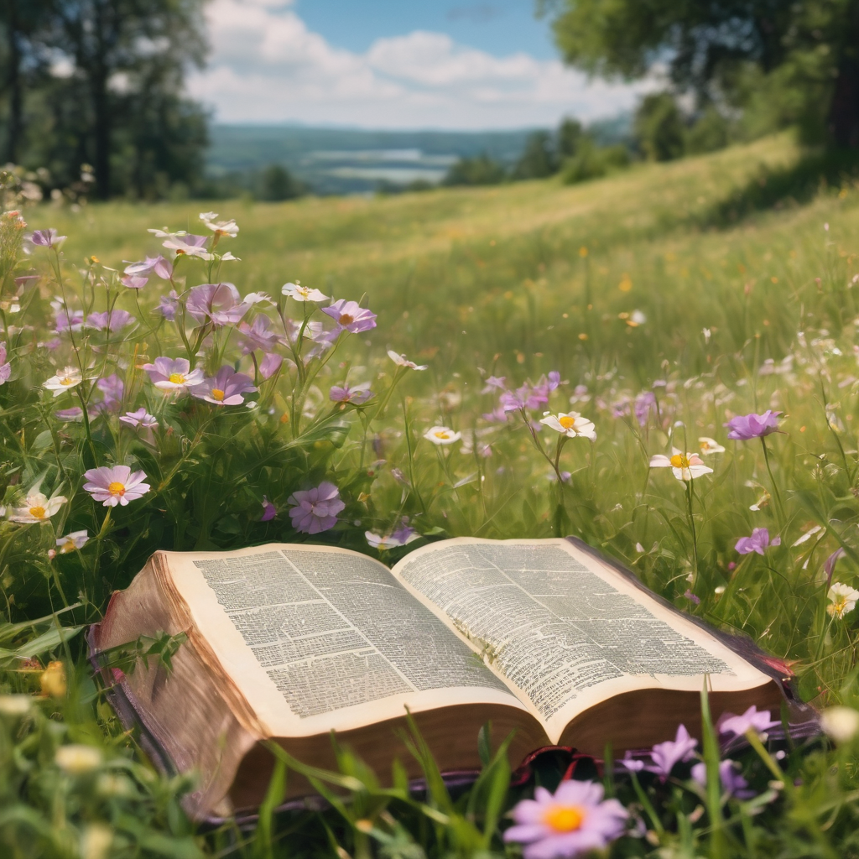
We pause before
​the Gospel ​​

Slide 28
Leader: A reading from Matthew 16.13-20
¹³ Now when Jesus came into the district of Caesarea Philippi, he asked his disciples, ‘Who do people say that the Son of Man is?’ ¹⁴ And they said, ‘Some say John the Baptist, but others Elijah, and still others Jeremiah or one of the prophets.’ ¹⁵ He said to them, ‘But who do you say that I am?’ ¹⁶ Simon Peter answered, ‘You are the Messiah, the Son of the living God.’ ¹⁷ And Jesus answered him, ‘Blessed are you, Simon son of Jonah! For flesh and blood has not revealed this to you, but my Father in heaven.
Continue…

Slide 29
¹⁸ And I tell you, you are Peter, and on this rock I will build my church, and the gates of Hades will not prevail against it. ¹⁹ I will give you the keys of the kingdom of heaven, and whatever you bind on earth will be bound in heaven, and whatever you loose on earth will be loosed in heaven.’ ²⁰ Then he sternly ordered the disciples not to tell anyone that he was the Messiah.
For the word of the Lord. Thanks be to God.​

Slide 30
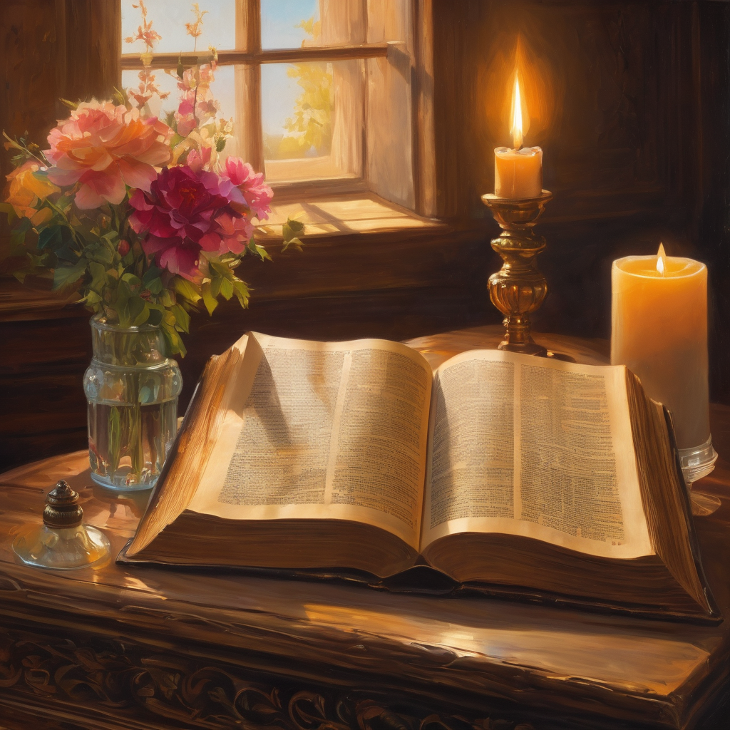
We pause
after ​the Gospel ​​

Slide 31
Leader: .
Leader and Cantor mute
Broadcaster exits screenshare
Flashback Sermon:
What’s your name?
Rev. Jamee
https://www.youtube.com/watch?v=1CM7r0n6Fg0
Notes:
Sermon starts 37:14 – Please let me know if the sermon is too quiet

Slide 32
Leader unmutes
Our next Hymn
Beauty For Brokenness
https://www.youtube.com/watch?v=D81ZD1NDPyE
We stay on mute
Leader mutes

Slide 33
The Leader and Cantor unmute
The Greeting of Peace
Leader: We are the body of Christ
All: God’s Spirit is with us
Leader: The peace of the Lord be always with you.
All: And also with you.
Leader: A sign of peace may be exchanged
You may like to type 'Peace' into the chat, use the 'raise hand’ or other reaction buttons, or just simply wave via the screen with your video turned on
(Broadcaster exits shared screen for a few moments for the exchange of peace)

Slide 34
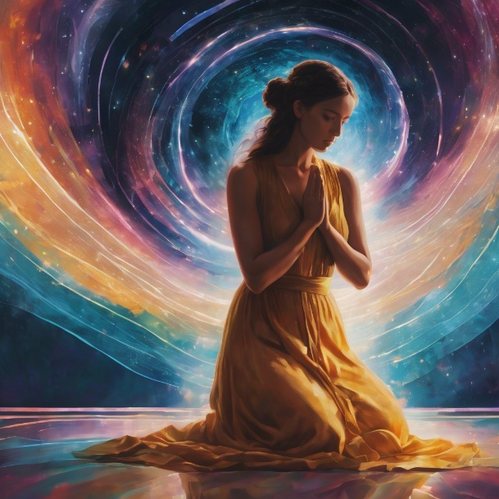
Prayer of Thanksgiving before Intercessions
Leader: As we enter prayer, I invite the second reader to unmute to lead our intercessions following the prayer of thanksgiving on the next slide. Please feel free to change your body position as you need.
Continue…

Slide 35
Leader:
We lift joyful hearts full of thanks and praise.
Thank you, Lord, that you do not leave us hiding in the reeds
but lead us, as you did Moses, into the plans you have for us.
We realise our true worth in you, with new life and direction.
You empower us to make a difference,
in our own lives as well as others.
Trusting in you, we remain alert to all opportunities
to grow in courage, strength and understanding.
We lift joyful hearts full of thanks and praise. Amen.
Notes:
Prayer of praise and thanksgiving

Slide 36
Intercessions
Reader 2: We pray for creation and communities we share our lives with. We pause for a few moments to name either in our hearts, or out loud, or in the chat, those environments and communities we bring to the Lord in prayer.
PAUSE…
Continue…

Slide 37
Intercessions
Reader 2: We entrust to you the community of Holy Hermits Online and our ministry partners:
Prosper the work of our hands and show us the way to your new creation.
Creator God, Hear our prayer.
St John's Cathedral Brisbane The Anglican Diocese of Southern Queensland St Gabriel’s, Carindale Benedictus Contemplative Church, Canberra Anglican Focus and Tithe.ly

Slide 38
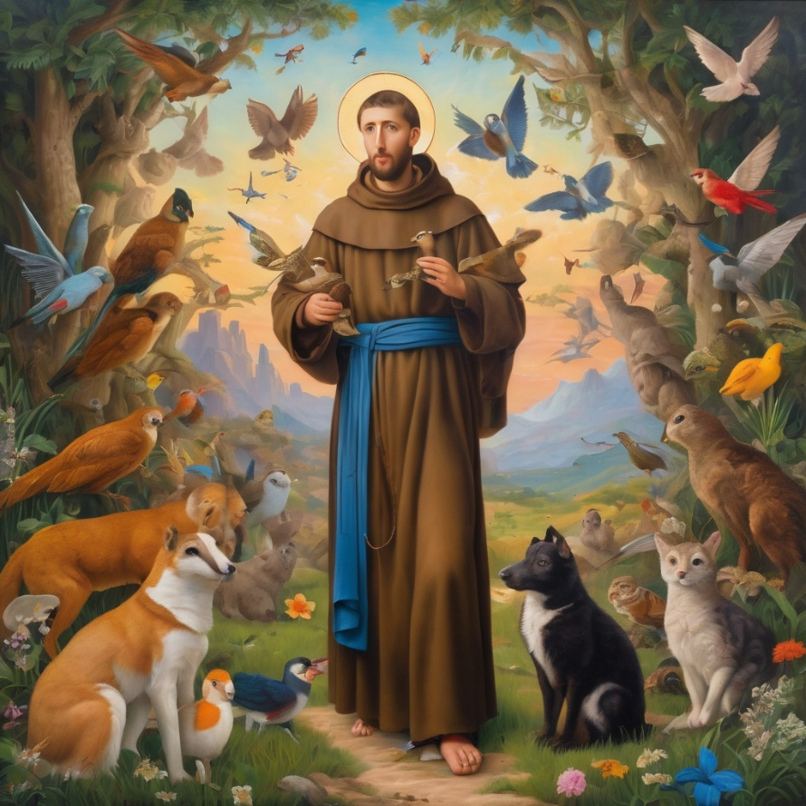
Reader 2: Loving Creator, we entrust to you all animals, especially those who are sick, anxious, ageing, lost, at risk, lonely, sad, hungry, in pain, homeless, abused, living in fear, encountering violence of any kind, in need of comfort, rehabilitation or transformation.

Slide 39
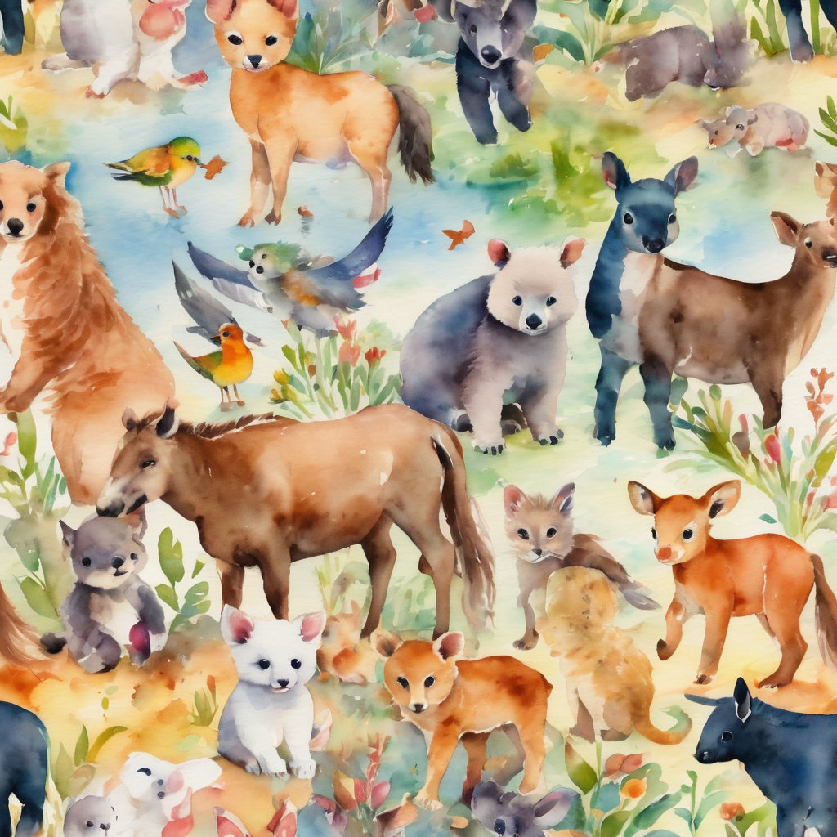
Reader 2: We invite your loving compassion for:
We name in our hearts, out loud or in the chat,
the animals we bring to the Lord in prayer. PAUSE…
Jasmine, ​
Leese(y), ​
Sid, Toots & Lulu​
Polly and Suki​
Fred, George & Percy​
Koshka ​
Jax
Lambert ​​
Kala, Nigel & Little One ​​
Toby​​
Taco​​
Paddy ​​
Rosie​
Squealer

Slide 40
Reader 2: Eternal Trinity of Love, we uphold to you the people we love and carry cares for:
Kerry, Les & Jake Julie, Ray, Tracey & Shane Mark, Desley & Bob ​​ Rachel, Mervyn & Gillian ​​Rev'd Shane & Janette​​ Alecia, Martin & Aidan​​ Kirsten, Greg, Daphne & Beau Bill & Marjorie​​ Aaron & Andrea Liz’s Godchildren Matthew & Nicholas | Barry​​ Dr Julie ​​ Ruth​​ Phil​ May Susan Tanya​ Neva Kathy ​Gayanne Tina | ​​ | Alan & Gaylene​ Jess & Leah ​​ Barry & Gwen Bob & Di​ Pat & Julie Dilys & Tony, Paul & Darhon Judy & Mary Miriam Lorelei Nettie

Slide 41
Reader 2:
We name in our hearts, out loud or in the chat, those we bring to the Lord in prayer.
PAUSE…
We entrust to you those who have died, those who have died peacefully and those who have died tragically, the old and the young. Receive them into your Kingdom. Lord in your mercy, Hear our prayers. Amen.

Slide 42
Pray Daily Cycle of Prayer
Leader: Loving God, joining with the Church in our cycle of prayer, we ask your blessings on:
The Church of the Province of West Africa
The Diocese of Tasmania: †Richard; Assistant Bishop – †Chris; Clergy and People
The Parish of Beenleigh: Alan – Locum, Frank, Doreen
Anglicare SQ Home and Community, North Coast Region
St Francis Theological College, Milton: Principal – Ruth; Academic Dean – Adam; staff, sessional lecturers & students

Slide 43
Commitment Prayer of the Week
Leader: Our commitment prayer for the week is for times of natural disaster
All things look to you, O Lord, to give them their food in due season: look in mercy on your people, and hear our prayer for those whose lives and possessions have been affected by natural disaster.
We ask that all our first responders, volunteers and emergency service workers be given strength and care, rest and recuperation.
Continue…
Notes:
Link to prayer group ministry page for weekly commitment prayer https://holyhermits.com.au/ministries/prayer-group

Slide 44
We uphold the vulnerable ones, children and animals, people living rough and in financial distress; that they be given courage and the appropriate support.
Please empower community groups and organisations as they step up. Encourage neighbours as they look out for one another. Inspire communities to support and resource animal organisations as they offer sanctuary and care for displaced animals—domestic, farm and wild.
Continue…
Notes:
Link to prayer group ministry page for weekly commitment prayer https://holyhermits.com.au/ministries/prayer-group

Slide 45
Give courage to all who work in ongoing trauma recovery; support workers, doctors, nurses, social workers, psychologists, veterinarians, counselling services, chaplains, clergy and local ministers. May they be enabled to sustain good self-care practices, access resources, find strength and resilience, peace and rest.
May all who suffer survivor guilt, be compassionate towards themselves and find grace in you. Holy Spirit please gently lead their energy into prayer, loving service and gratitude, so they can experience and share peace.
Continue…
Notes:
Link to prayer group ministry page for weekly commitment prayer https://holyhermits.com.au/ministries/prayer-group

Slide 46
We entrust the rebuilding efforts into your care Lord. May the resources needed become available, the trades people offering their skills be honest and diligent.
We hold before you Lord, local council and governments especially politicians and leaders as they represent people and places. Give them inspiration, wisdom and discernment.
Continue…
Notes:
Link to prayer group ministry page for weekly commitment prayer https://holyhermits.com.au/ministries/prayer-group

Slide 47
In your mercy restore your creation and heal our lands, air and waterways, regenerate all that has been destroyed and inspire people to help with that new growth and restoration.
So guide and bless your people, that we may enjoy the fruits of the earth and give you thanks with grateful hearts, through our Lord Jesus Christ. Amen.
Notes:
Link to prayer group ministry page for weekly commitment prayer https://holyhermits.com.au/ministries/prayer-group

Slide 48
Leader: Let us pray together the prayer which Jesus gave us saying:
All: Our Father in heaven, hallowed be your name,
your kingdom come, your will be done, on earth as in heaven.
Give us today our daily bread.
Forgive us our sins
as we forgive those who sin against us.
Save us from the time of trial and deliver us from evil.
For the kingdom, the power, and the glory are yours
now and for ever.
Amen.

Slide 49
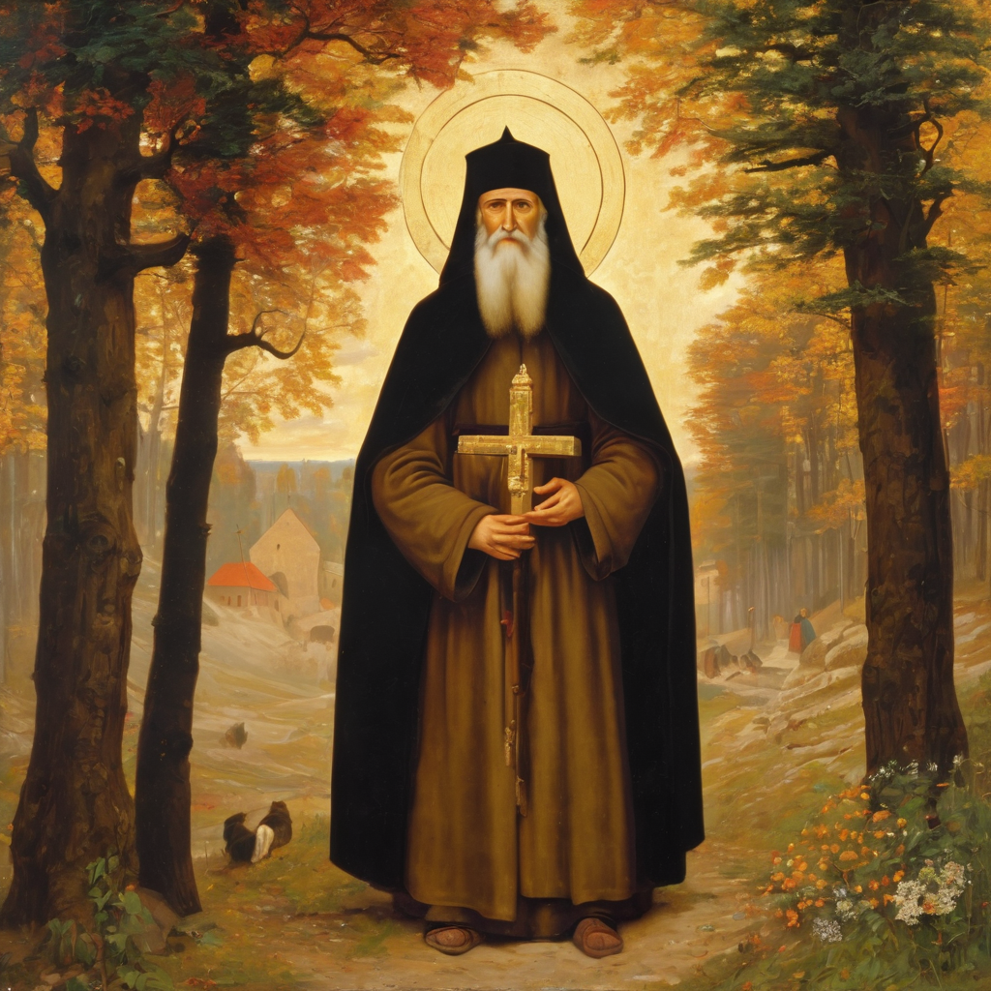
Devotions

Slide 50
Hermit Wisdom - Sergius’ Teachings
Sergius’ community at Holy Trinity served as a model for secluded ascetic life in organised communities outside towns and cities.
He was committed to poverty and to sincerity.
He led by example, giving help to all who sought it, establishing monastery schools and teaching farmers better methods of farming.
He combined detachment from the world with sacrificial service for the common good.

Slide 51
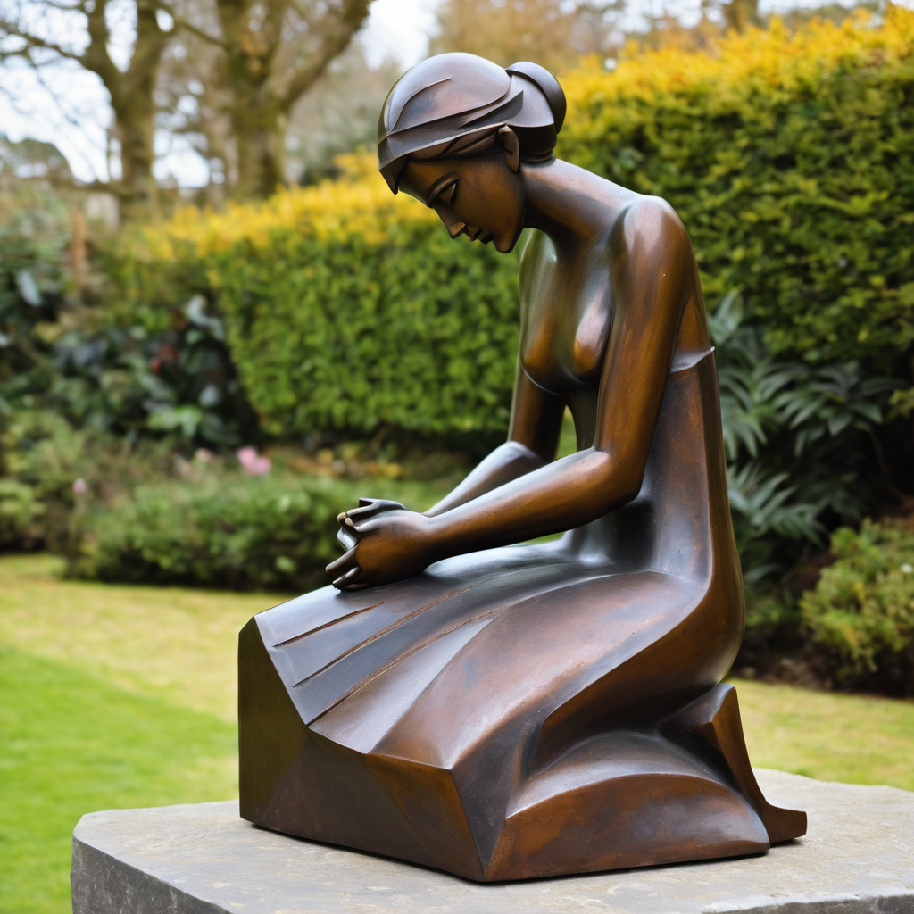
​
Leader: ​As we enter a few minutes of silence together, you are invited to pray the prayer of adoration on the next slide and/or spend this time in contemplation. ​
The Spiritual Communion prayer follows on the slide after that.
Let us be still.
Leader and Cantor Mute.
Continue…

Slide 52
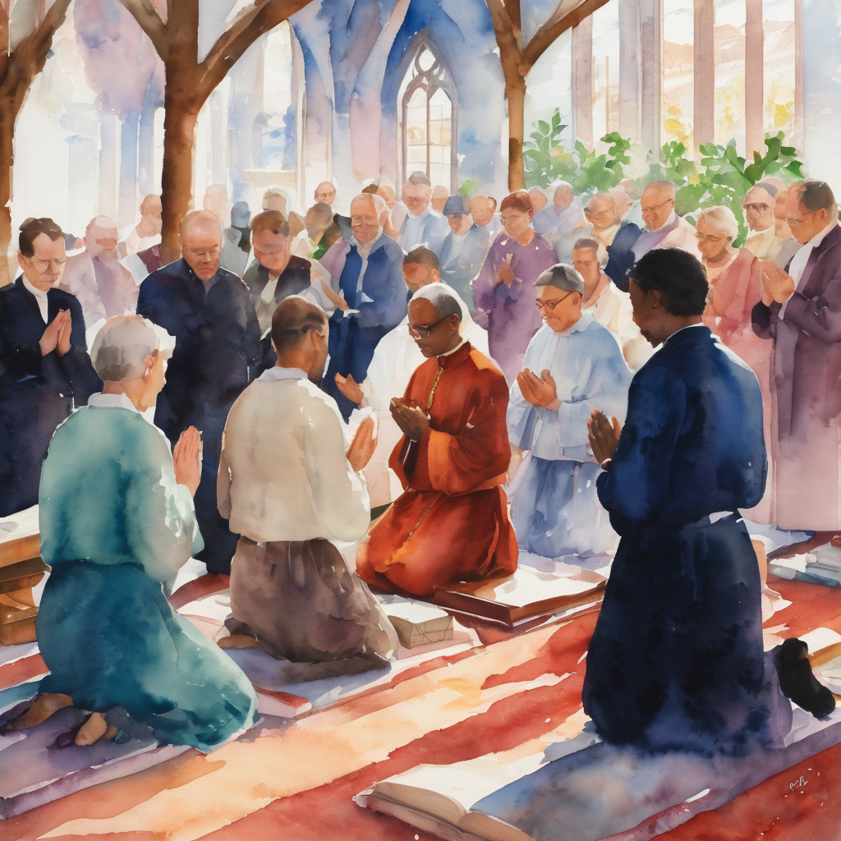
​
Lord, let our words be words of kindness,
our thoughts be those of care,
our ears be ready to hear your voice,
our hearts filled with your love,
our hands reach out to help others
and our feet be ready to march for truth.
Amen.
Notes:
Prayer for all ages

Slide 53

  Oh, my Lord Jesus I turn to you present at the Altar and in the Tabernacle. I believe that you are present in the Holy Sacrament of your most Sacred Body and Blood. I love you above all things and I desire to receive you into my Soul. I cannot at this moment receive you Sacramentally in Holy Communion. Come spiritually into my heart. Purify it, Sanctify it. Render my heart like your own heart. I embrace you as if you were already there and unite myself wholly with you. Never permit me to be separated from you. Lord, I am not worthy to receive you, but only say the word and I shall be healed. Amen
Making a Spiritual Communion
(Prayed in silence)

Slide 54
Leader unmutes
Our final song is
Lord of All Hopefulness
https://www.youtube.com/watch?v=gTDmsQsLpeg
​We stay on mute
Leader and Cantor mute

Slide 55
Leader and cantor unmute
Sending Prayer
Leader: We pray our sending prayer together.
All: May we be empowered to show loving resistance,
inspired by Jesus’ example and strengthened by his Spirit.
May we stand strong in our faith,
to challenge injustice, speaking up for those with no voice,
showing and sharing Christ in our community.
Amen.

Slide 56
The Benediction
Leader: Let us all invite God’s blessings together,
All: May the Lord bless us and keep us.
May the Lord’s face shine upon us and be gracious to us.
May the Lord’s countenance be lifted upon us,
and bring us peace.
Amen

Slide 57
Notices
Study Group Wednesday @ 6pm. We will be exploring a contemplative prayer series featuring seven poetic blessings written by Christine Valters. All are welcome to attend.
Next Sunday Contemplative Services workshop @ 11am
See HHO Events page for further upcoming events HHO Events

Slide 58
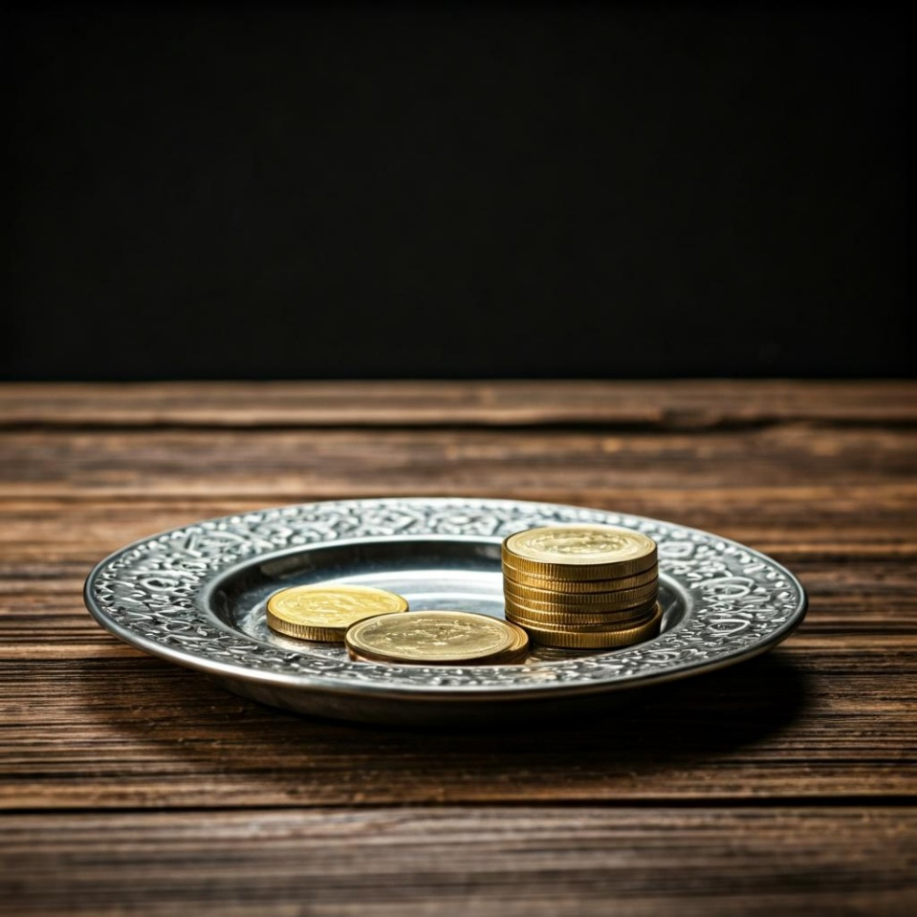
Leader: Thank you for your regular gifts to this ministry. Offerings are most welcome via:
The HHO App
Direct Debit
International Direct Debit
Please consider a one-off donation
or leaving a legacy in your Will
For further information go to HHO give page https://holyhermits.com.au/give

Slide 59
Serving next week
30th August 2026
14th Sunday after Pentecost
9:00 am AEST
Service Prep: Kris | Chat Host: Viki | First Reader: Liz
Music: Wiggles | Welcomer: Julie | Second Reader: Kieron
Proof-reader: Lauren | Priest: N/A | Preacher: Lauren
Broadcaster: Lauren | Deacon: Lauren | Fellowship: Lauren
Backup Broadcaster: Barry | Leader: Jeremy | Safety Officer: Julie
Zoom Buttons: Viki | Cantor: Julie | Attendance: Viki
Thank you for your ministry gifts
New Servers always welcome!
Please email Rev’d Lauren to get involved
holyhermits@anglicanchurchsq.org.au

Slide 60
The Dismissal
Leader: I invite everyone to unmute for the Dismissal
Leader: Go in peace to love and serve the Lord.
All: In the name of Christ, Amen.

Slide 61
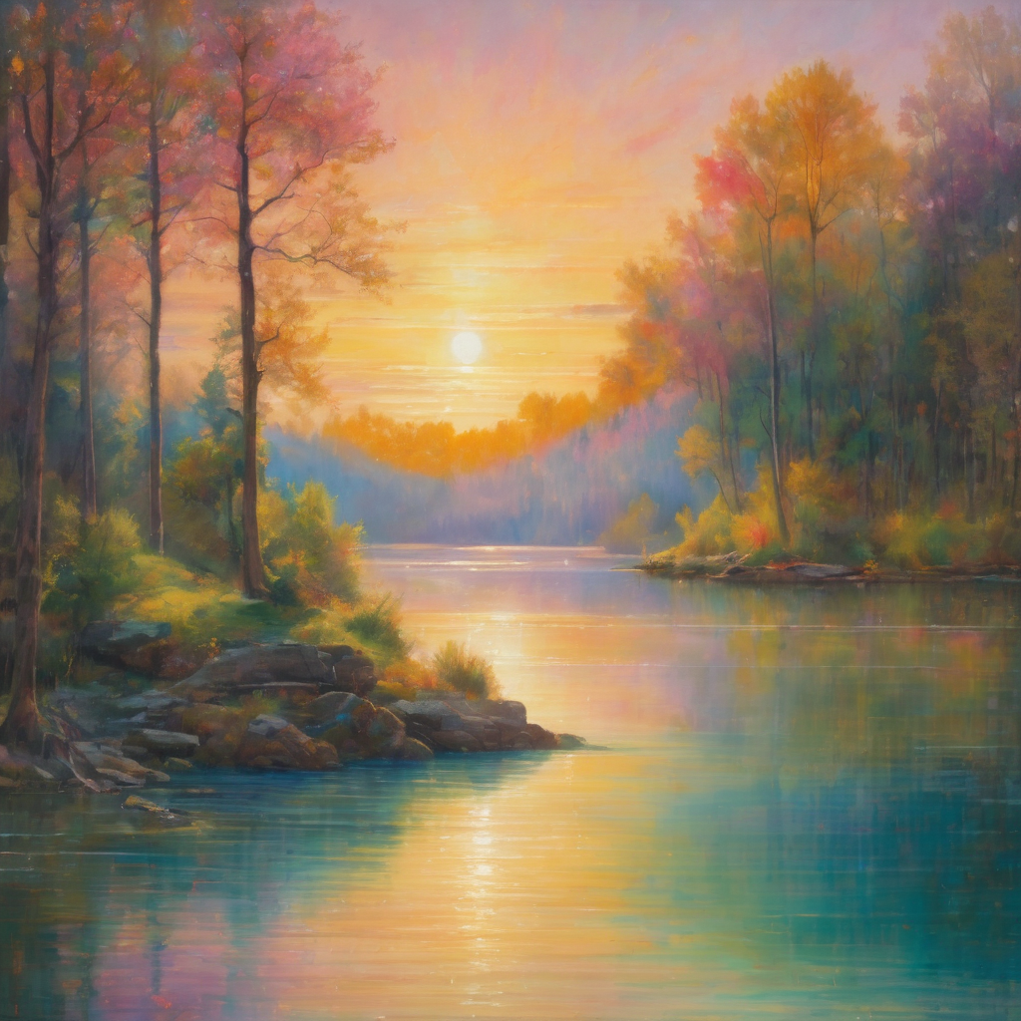
Fellowship
Thank you, Lauren for leading Fellowship
Please feel welcome to linger or pop a message in the chat and head off when you are ready.​
Extra resources developed
by Roots on the Web
Images from Padlet

