Slide 1
Welcome to Holy Hermits Online Worship
16th Sunday after Pentecost
Today, we are celebrating
The Season of Creation
Service Prep: Paul | Chat Host: Rachel | Fellowship: Lauren
Music: Paul | Welcomer: Chris | Safety Officer: Rachel
Proof-reader: Lauren | Leader: Jeremy | Attendance: Rachel
Broadcaster: Barry | Cantor: Margo | Preacher: Paul
Backup Broadcaster: Lauren | First Reader: Bob | Deacon: Lauren
Zoom Buttons: Rachel | Second Reader: Helen | Priest: N/A
Notes:
Please try to keep all fonts size 28 with 1.5 spacing so that it is easier for people to read
Readers with an ‘*’ after their name in the roster are down to pre-record, please include ‘*’ in the slide

Slide 2


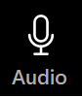



Hospitality
Leader:
Please mute for the service unless invited to offer your voice as part of the service ministry
Have the video camera on or off and turn the volume and brightness up or down on your device if things are too loud 🔉🔊or too bright🔅🔆
Our Cantor acts as our voice, offering the responses, in Bold Text, which we say together
Feel welcome to use the chat and reaction emojis 👍
🙏 Please take care of yourself in this space. 🙏 Come and go as you need
😴 It is great to take rest in this space, so falling asleep is also OK 😴
👂️ Remember, pastoral care is available to all in the community, if you'd like to speak to someone about anything spiritual. ❤️ Visit the help page at the website to reach out 🌐
Our Being Together ethos and safeguarding practices can also be accessed on the website 🫶​
🙌 Come as you are – we are all here together! 🙌
Notes:
Used Lent 2022

Slide 3
Invitation
Leader: As we come into worship let’s take a few
deep breaths,
Let go of anything that isn’t serving us,
And become aware of God’s presence here with us.
Opening Music: The Kingsfold Trumpet
https://youtu.be/HyZAGP6l3sw?si=9Ivfj2ITJYko7he1

Slide 4
Leader and Cantor unmute
The Greeting
Leader:
The grace of the Lord Jesus Christ,
and the love of God,
and the fellowship of the Holy Spirit,
be with you all.
All: And also with you.

Slide 5
Gathering Prayer
Leader:
Are you ready?
It’s time to go.
It’s time to go with God.
We’re going on a journey.
We’re going on a journey with God.
Let’s go together.
Let’s go together with God today.
Notes:
Use Call to Worship Prayer https://www.rootsontheweb.com

Slide 6
Gathering Prayer
All:
God who created the world,
we gather here from many places,
be with us here.
God who saves us,
we bring our fears and our questions,
guide us and protect us.
Uniting God, we come as pilgrims to journey together.
Let us know you here as we journey with you. Amen.
Notes:
Use gathering prayer - Roots

Slide 7
Sentence
Leader: I invite our Cantor to proclaim the sentence for today.
Cantor: If you, O Lord, should note what we do wrong, Lord, who could stand? But there is forgiveness with you, so that you may be revered.
Psalm 130.3–4
Notes:
From Epray – ensure the text is black and font size is 28

Slide 8
Prayer of Approach
Leader: We pray the prayer of approach together
All: God of our journey of faith:
Wherever you send us, we will go.
Wherever you lead us, we will follow.
Whenever we stumble, we will reach out to you.
Whenever we are afraid, we will trust you.
Wherever we gather, we will worship you.
Continue…
Notes:
Prayer of Approach from Roots

Slide 9
Wherever we gather, we will worship you.
Whenever we hear your word, we will embrace you.
All our days, we will honour you.
In ones and twos and in tens and hundreds, we will praise you.
In Jesus’ name.
Notes:
Prayer of Approach from Roots

Slide 10
Leader unmutes
Our first Hymn
Jesu, Lover of My Soul
https://youtu.be/AvluR3KbPDs?si=NwvwUZg3AA5llIB7
We stay on mute
Leader mutes

Slide 11
The Deacon or LA introduces the Confession​
God is steadfast in love and infinite in mercy, welcoming sinners and inviting them to the Lord's table.
Silence may be kept.​
Let us confess our sins in penitence and faith, with a sincere and a true heart.
Notes:
Epray – has seasonal variation

Slide 12
All: ​Merciful God, our maker and our judge, ​
we have sinned against you ​in thought, word, and deed, ​
and in what we have failed to do: ​
we have not loved you with our whole heart; ​
we have not loved our neighbours as ourselves; ​
we repent, and are sorry for all our sins.​
Father, forgive us. Strengthen us to love and obey you
in newness of life; ​through Jesus Christ our Lord. ​
Amen.​

Slide 13
Words of Assurance offered by the Deacon or LA
These words of assurance from the First Letter of John declare that:
If anyone sins, we have an advocate with the Father, Jesus Christ the righteous. He is the perfect offering for our sin, and not for ours only, but for the sins of the whole world.
(1 John 2: 1-2)
In this is love, not that we loved God, but that he loved us and sent his Son to be the perfect offering for our sins.
(1 John 4:10)

Slide 14
Collect
Leader: O God,
you call your Church to witness that in Christ
we are reconciled to you:
help us so to proclaim the good news of your love,
that all who hear it may turn to you;
through Jesus Christ our Lord,
who lives and reigns with you and the Holy Spirit,
one God, now and for ever. Amen.
Notes:
From Epray – ensure the text is black and font size is 28

Slide 15
The 1st reader unmutes
Leader: I invite the 1st reader to unmute and offer the 1st reading when ready
Reader 1: The 1st Reading is from Exodus 14.19-31
¹⁹ The angel of God who was going before the Israelite army moved and went behind them; and the pillar of cloud moved from in front of them and took its place behind them. ²⁰ It came between the army of Egypt and the army of Israel. And so the cloud was there with the darkness, and it lit up the night; one did not come near the other all night.
Continue…
Notes:
If the 1st reading is recorded change the introduction to “Leader: We will now listen to the first reading”
(Normal introduction: “I invite the 1st reader to unmute and offer the 1st lesson when ready”)
** Note the Cantor still responds with “Thanks be to God” at the conclusion of the reading even if the reading is recorded
From Epray – ensure the text is black and font size is 28

Slide 16
²¹ Then Moses stretched out his hand over the sea. The Lord drove the sea back by a strong east wind all night, and turned the sea into dry land; and the waters were divided. ²² The Israelites went into the sea on dry ground, the waters forming a wall for them on their right and on their left. ²³ The Egyptians pursued, and went into the sea after them, all of Pharaoh’s horses, chariots, and chariot drivers. ²⁴ At the morning watch the Lord in the pillar of fire and cloud looked down upon the Egyptian army, and threw the Egyptian army into panic.
Continue…

Slide 17
²⁵ He clogged their chariot wheels so that they turned with difficulty. The Egyptians said, ‘Let us flee from the Israelites, for the Lord is fighting for them against Egypt.’ ²⁶ Then the Lord said to Moses, ‘Stretch out your hand over the sea, so that the water may come back upon the Egyptians, upon their chariots and chariot drivers.’ ²⁷ So Moses stretched out his hand over the sea, and at dawn the sea returned to its normal depth. As the Egyptians fled before it, the Lord tossed the Egyptians into the sea.
Continue…

Slide 18
²⁸ The waters returned and covered the chariots and the chariot drivers, the entire army of Pharaoh that had followed them into the sea; not one of them remained. ²⁹ But the Israelites walked on dry ground through the sea, the waters forming a wall for them on their right and on their left. ³⁰ Thus the Lord saved Israel that day from the Egyptians; and Israel saw the Egyptians dead on the seashore.
³¹ Israel saw the great work that the Lord did against the Egyptians. So the people feared the Lord and believed in the Lord and in his servant Moses.
For the word of the Lord. Thanks be to God.​

Slide 19
Leader: We now say the psalm antiphonally, I invite the first reader to lead, and we will all respond with our cantor as our voice.
¹ When Israel came out of Egypt:
and the house of Jacob from among a people of an alien tongue,
² Judah became his sanctuary:
and Israel his dominion.
³ The sea saw that, and fled:
Jordan was driven back.
Psalm 114
Continue…
Notes:
From Epray – ensure the text is black and font size is 28
If the 1st reading is recorded please:
add The Leader will lead the Psalm to the top left of the screen in the liturgical colour
change the introduction to the Psalm to “Leader: We now say the psalm antiphonally, we will all respond with our cantor as our voice.”
- Normal introduction: “We now say the psalm antiphonally, I invite the first reader to lead, and we will all respond with our cantor as our voice.”

Slide 20
⁴ The mountains skipped like rams:
and the little hills like young sheep.
⁵ What ailed you, O sea, that you fled:
O Jordan, that you were driven back?
⁶ You mountains, that you skipped like rams:
and you little hills like young sheep?
Continue…

Slide 21
⁷ Tremble, O earth, at the presence of the Lord:
at the presence of the God of Jacob,
⁸ Who turned the rock into a pool of water:
and the flint-stone into a welling spring.

Slide 22
The 2nd reader unmutes
Leader: I invite the 2nd reader to unmute and offer the 2nd
reading when ready.
Reader 2: The 2nd Reading is from Romans 14.1-14
¹ Welcome those who are weak in faith, but not for the purpose of quarrelling over opinions. ² Some believe in eating anything, while the weak eat only vegetables. ³ Those who eat must not despise those who abstain, and those who abstain must not pass judgement on those who eat; for God has welcomed them. ⁴ Who are you to pass judgement on servants of another? It is before their own lord that they stand or fall. And they will be upheld,
Continue…
Notes:
From Epray – ensure the text is black and font size is 28

Slide 23
for the Lord is able to make them stand. It is before their own lord that they stand or fall. And they will be upheld, for the Lord is able to make them stand. ⁵ Some judge one day to be better than another, while others judge all days to be alike. Let all be fully convinced in their own minds. ⁶ Those who observe the day, observe it in honour of the Lord. Also those who eat, eat in honour of the Lord, since they give thanks to God; while those who abstain, abstain in honour of the Lord and give thanks to God.
Continue…

Slide 24
⁷ We do not live to ourselves, and we do not die to ourselves.
⁸ If we live, we live to the Lord, and if we die, we die to the Lord; so then, whether we live or whether we die, we are the Lord’s.
⁹ For to this end Christ died and lived again, so that he might be Lord of both the dead and the living. ¹⁰ Why do you pass judgement on your brother or sister? Or you, why do you despise your brother or sister? For we will all stand before the judgement seat of God.
¹¹ For it is written,
‘As I live, says the Lord, every knee shall bow to me,
and every tongue shall give praise to God.’
Continue…

Slide 25
¹² So then, each of us will be accountable to God.
¹³ Let us therefore no longer pass judgement on one another, but resolve instead never to put a stumbling-block or hindrance in the way of another. ¹⁴ I know and am persuaded in the Lord Jesus that nothing is unclean in itself; but it is unclean for anyone who thinks it unclean.
For the word of the Lord. Thanks be to God.​

Slide 26

We pause before
​the Gospel ​​

Slide 27
Deacon: The Gospel of our Lord Jesus Christ according to St Matthew Chapter 18 beginning at the 21st verse.
All: Glory to you Lord Jesus Christ.
²¹ Then Peter came and said to him, ‘Lord, if another member of the church sins against me, how often should I forgive? As many as seven times?’ ²² Jesus said to him, ‘Not seven times, but, I tell you, seventy-seven times. ²³ ‘For this reason the kingdom of heaven may be compared to a king who wished to settle accounts with his slaves.
Continue…
Notes:
From Epray – ensure the text is black and font size is 28
Please note that there is a different introduction and final response if this is lay led

Slide 28
²⁴ When he began the reckoning, one who owed him ten thousand talents was brought to him; ²⁵ and, as he could not pay, his lord ordered him to be sold, together with his wife and children and all his possessions, and payment to be made. ²⁶ So the slave fell on his knees before him, saying, “Have patience with me, and I will pay you everything.” ²⁷ And out of pity for him, the lord of that slave released him and forgave him the debt. ²⁸ But that same slave, as he went out, came upon one of his fellow-slaves who owed him a hundred denarii; and seizing him by the throat, he said, “Pay what you owe.”
Continue…

Slide 29
²⁹ Then his fellow-slave fell down and pleaded with him, “Have patience with me, and I will pay you.” ³⁰ But he refused; then he went and threw him into prison until he should pay the debt.
³¹ When his fellow-slaves saw what had happened, they were greatly distressed, and they went and reported to their lord all that had taken place. ³² Then his lord summoned him and said to him, “You wicked slave! I forgave you all that debt because you pleaded with me. ³³ Should you not have had mercy on your fellow-slave, as I had mercy on you?”
Continue…

Slide 30
³⁴ And in anger his lord handed him over to be tortured until he should pay his entire debt. ³⁵ So my heavenly Father will also do to every one of you, if you do not forgive your brother or sister from your heart.’
This is the Gospel of the Lord. Praise to you Lord Jesus Christ.

Slide 31
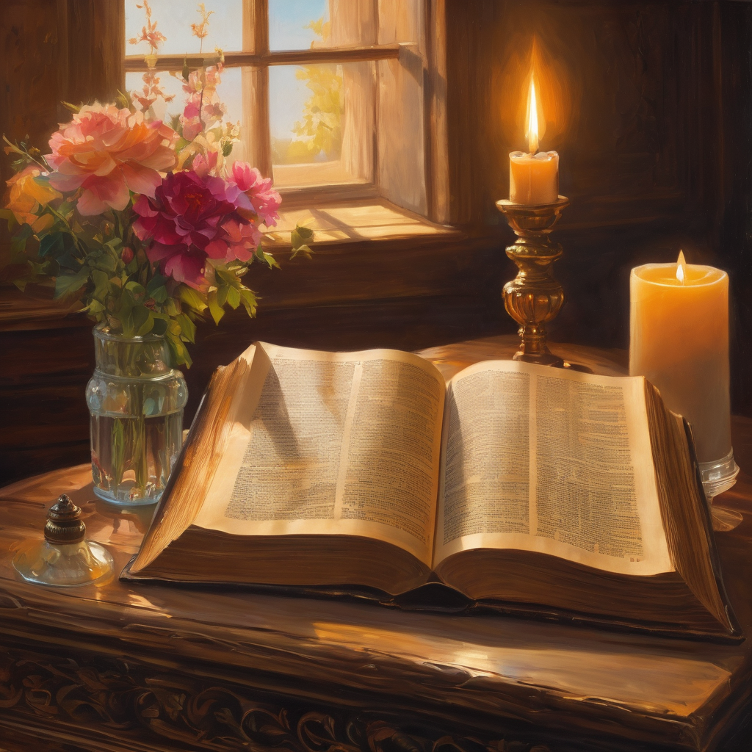
We pause
after ​the Gospel ​​

Slide 32
Leader: The Sermon is recorded to YouTube for sharing later.
Only the preacher's video and audio will be recorded.
The chat and other participants' feeds remain out of sight of the recording.
Leader and Cantor mute
Broadcaster exits screenshare
Preacher unmutes
Zoom buttons ”pins” preacher’s screen + selects “record to the cloud”
Sermon

Slide 33
Leader unmutes
Our next Hymn
God, How Can We Forgive
https://youtu.be/IfDLg_IvGg4?si=jEbsgeCe9oT-SKXP
We stay on mute
Leader mutes

Slide 34
The Leader and Cantor unmute
The Greeting of Peace
Leader: We are the body of Christ
All: God’s Spirit is with us
Leader: The peace of the Lord be always with you.
All: And also with you.
Leader: A sign of peace may be exchanged
You may like to type 'Peace' into the chat, use the 'raise hand’ or other reaction buttons, or just simply wave via the screen with your video turned on
(Broadcaster exits shared screen for a few moments for the exchange of peace)

Slide 35
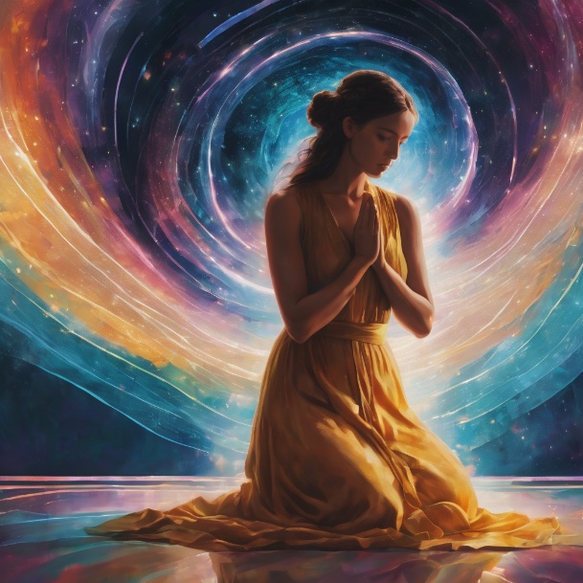
Prayer of Thanksgiving before Intercessions
Leader: As we enter prayer, I invite the second reader to unmute to lead our intercessions following the prayer of thanksgiving on the next slide. Please feel free to change your body position as you need.
Continue…

Slide 36
Leader: Blessed are you forever, God.
You are with us every step of the way:
raising us up, cheering us on, guiding us,
shaping us, teaching us and drawing us closer to you.
With the dawn chorus of the waking birds
and the sparkling of the evening stars,
we will always praise and worship you.
Ready to follow wherever you lead.
In Jesus’ name. Amen.
Notes:
Prayer of praise and thanksgiving from Roots (if it’s too long still add it and it will be sorted out ☺)

Slide 37
Intercessions
Reader 2: We pray for creation and communities we share our lives with. We pause for a few moments to name either in our hearts, or out loud, or in the chat, those environments and communities we bring to the Lord in prayer.
PAUSE…
Continue…

Slide 38
Intercessions
Reader 2: We entrust to you the community of Holy Hermits Online and our ministry partners:
Prosper the work of our hands and show us the way to your new creation.
Creator God, Hear our prayer.
St John's Cathedral Brisbane The Anglican Diocese of Southern Queensland St Gabriel’s, Carindale Benedictus Contemplative Church, Canberra Anglican Focus and Tithe.ly

Slide 39
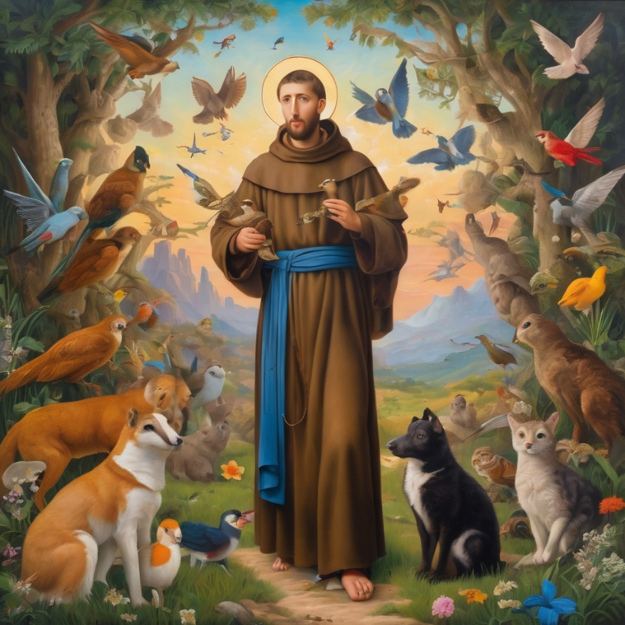
Reader 2: Loving Creator, we entrust to you all animals, especially those who are sick, anxious, ageing, lost, at risk, lonely, sad, hungry, in pain, homeless, abused, living in fear, encountering violence of any kind, in need of comfort, rehabilitation or transformation.

Slide 40
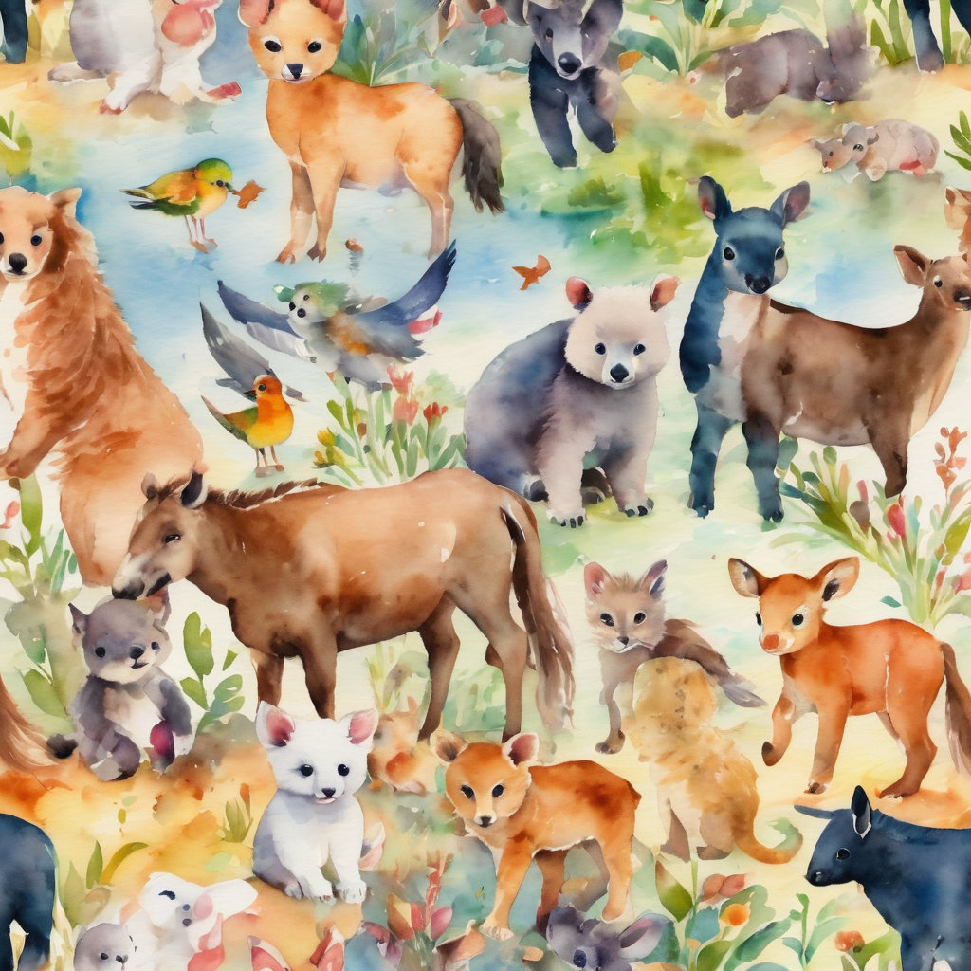
Reader 2: We invite your loving compassion for:
We name in our hearts, out loud or in the chat,
the animals we bring to the Lord in prayer. PAUSE…
Jasmine, ​
Leese(y), ​
Sid, Toots & Lulu​
Polly and Suki​
Fred, George & Percy​
Koshka ​
Jax
Lambert ​​
Kala, Nigel & Little One ​​
Toby​​
Taco​​
Paddy ​​
Rosie​

Slide 41
Reader 2: Eternal Trinity of Love, we uphold to you the people we love and carry cares for:
Kerry, Les & Jake Julie, Ray, Tracey & Shane Mark, Desley & Bob ​​ Rachel, Mervyn & Gillian ​​Rev'd Shane & Janette​​ Alecia, Martin & Aidan​​ Kirsten, Greg, Daphne & Beau Bill & Marjorie​​ Aaron & Andrea Liz’s Godchildren Matthew & Nicholas | Barry​​ Dr Julie ​​ Ruth​​ Phil​ May Susan Tanya​ Neva Kathy ​Gayanne Tina | ​​ | Alan & Gaylene​ Jess & Leah ​​ Barry & Gwen Bob & Di​ Pat & Julie Dilys & Tony, Paul & Darhon Judy & Mary Miriam Lorelei Nettie

Slide 42
Reader 2:
We name in our hearts, out loud or in the chat, those we bring to the Lord in prayer.
PAUSE…
We entrust to you those who have died, those who have died peacefully and those who have died tragically, the old and the young. Receive them into your Kingdom. Lord in your mercy, Hear our prayers. Amen.

Slide 43
Pray Daily Cycle of Prayer
Leader: Loving God, joining with the Church in our cycle of prayer, we ask your blessings on:
The Anglican Church in Aotearoa, New Zealand and Polynesia
Ministry with the Aboriginal People of Australia: †Chris
The Parish of Clayfield St Mark’s: Lynette, Gary, Peter
St John’s Community Care Services, Burleigh Heads
St Luke’s Anglican School, Bundaberg: Principal – Matthew; Chaplain – Vacant; Chair of School Council – Darren; members of School Council; staff & students
Notes:
anglicanfocus.org.au/category/front-page/spirituality/pray-daily/
Please only include the first names of those we pray for

Slide 44
Commitment Prayer of the Week
Leader: Our commitment prayer for the week is
A Prayer of Lament
https://www.youtube.com/watch?v=d8tLRZWOAcw
Notes:
Link to prayer group ministry page for weekly commitment prayer Prayer Group | Ministries | Holy Hermits Online https://holyhermits.com.au/ministries/prayer-group

Slide 45
Leader: Let us pray together the prayer which Jesus gave us saying:
All: Our Father in heaven, hallowed be your name,
your kingdom come, your will be done, on earth as in heaven.
Give us today our daily bread.
Forgive us our sins
as we forgive those who sin against us.
Save us from the time of trial and deliver us from evil.
For the kingdom, the power, and the glory are yours
now and for ever.
Amen.

Slide 46
Devotions

Slide 47
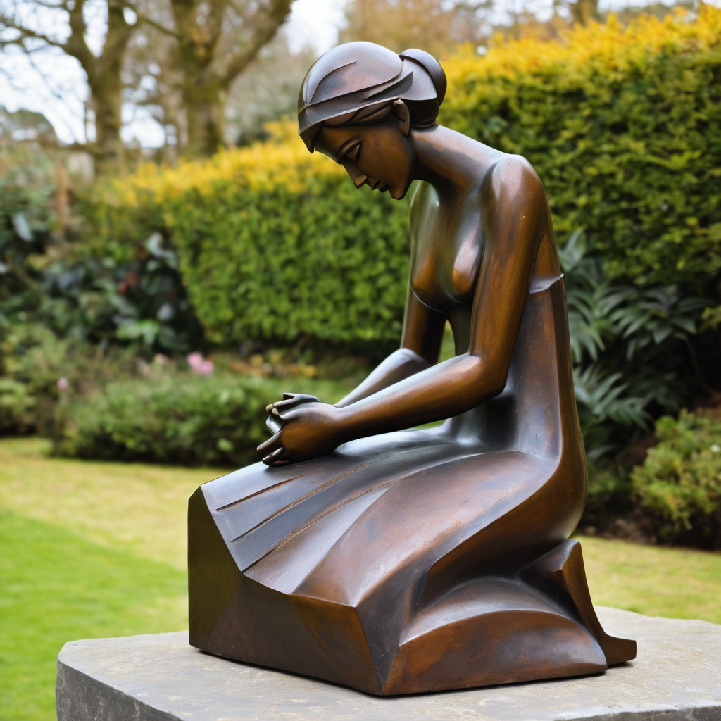
​
Leader: ​As we enter a few minutes of silence together, you are invited to pray the prayer of adoration on the next slide and/or spend this time in contemplation. ​
The Spiritual Communion prayer follows on the slide after that.
Let us be still.
Leader and Cantor Mute.
Continue…

Slide 48
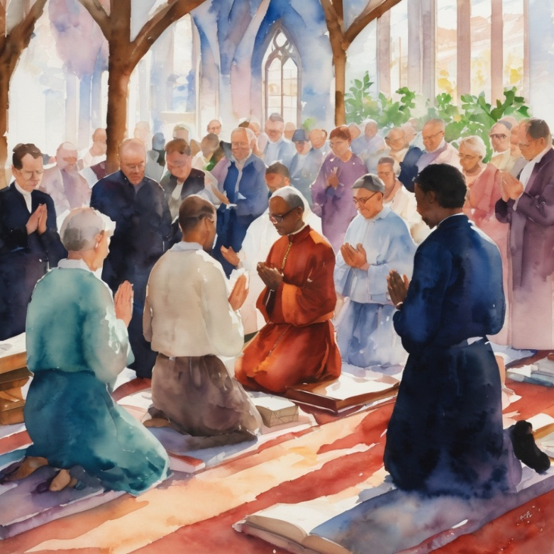
​
Help us, God,
to go with you, knowing you’re leading us:
out of bad choices and into good choices,
out of fighting and into peace,
out of hate and into love.
Help us to know you with us,
walking alongside us in all of life. Amen.
Notes:
Prayer for all ages from Roots

Slide 49

  Oh, my Lord Jesus I turn to you present at the Altar and in the Tabernacle. I believe that you are present in the Holy Sacrament of your most Sacred Body and Blood. I love you above all things and I desire to receive you into my Soul. I cannot at this moment receive you Sacramentally in Holy Communion. Come spiritually into my heart. Purify it, Sanctify it. Render my heart like your own heart. I embrace you as if you were already there and unite myself wholly with you. Never permit me to be separated from you. Lord, I am not worthy to receive you, but only say the word and I shall be healed. Amen
Making a Spiritual Communion
(Prayed in silence)
Notes:
Spiritual Communion Slide – Please do not change the prayer
Can change colour of background and title to match liturgical colour. You may also like to change the picture.

Slide 50
Leader unmutes
Our final song is
Forgive our sins as we forgive
https://youtu.be/HixCQUirJxg?si=J7UizcuS7bOopWTj
We stay on mute
Leader mutes

Slide 51
Leader and cantor unmute
Sending Prayer
Leader: We pray our sending prayer together.
All: Let us have courage,
as we know God before us.
Let us have faith,
as we know God beside us.
Let us have joy,
as we know God behind us.
Let us have love,
as we know God goes with us.Amen.
Notes:
Use Sending Prayer from Roots

Slide 52
The Benediction
Leader: Let us all invite God’s blessings together,
All: May the road rise up to meet us,
may the wind be always at our backs,
may the sun shine warm upon our faces,
and the rains fall soft upon our fields;
and until we meet again,
may God hold us in the palm of his hand. Amen.
Notes:
We have a different benediction for our birthday (we will keep using this through the Season of Creation)
The Normal Benediction:
May the Lord bless us and keep us.
May the Lord’s face shine upon us and be gracious to us.
May the Lord’s countenance be lifted upon us,
and bring us peace.
Amen

Slide 53
Notices
Earth, Our Original Monastery Wednesday @ 6pm. Continuing our contemplative prayer series. All are welcome to attend.
This Sunday our Open Space Meeting @ 11am
If you are able, please stay after the service for fellowship and a couple of community updates.
See HHO Events page for further upcoming events HHO Events
Notes:
Up coming events can be added from the HHO event page/calendar

Slide 54
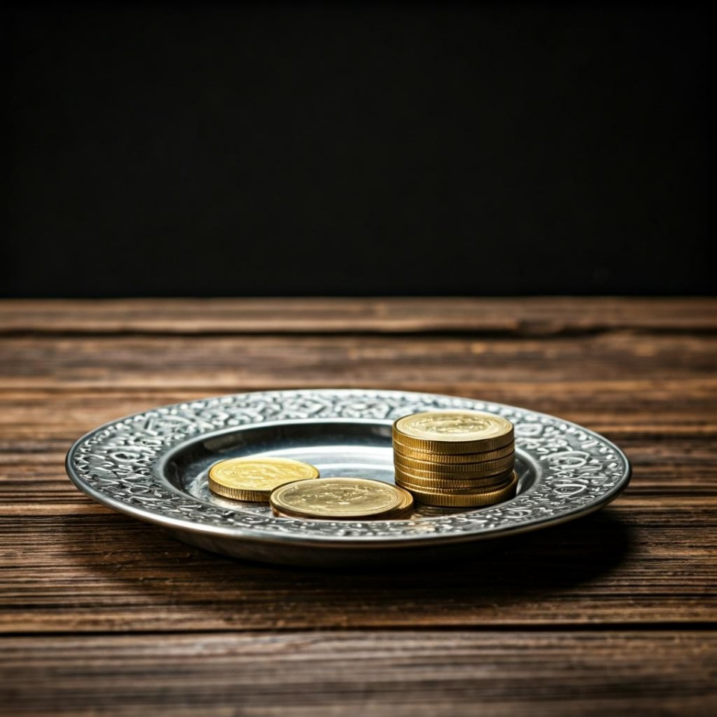
Leader: Thank you for your regular gifts to this ministry. Offerings are most welcome via:
The HHO App
Direct Debit
International Direct Debit
Please consider a one-off donation
or leaving a legacy in your Will
For further information go to HHO give page https://holyhermits.com.au/give

Slide 55
Serving next week
20 September 2026
17th Sunday after Pentecost
9:00 am AEST
Service Prep: Kristine | Chat Host: Viki | Fellowship: Lauren
Music: Wiggles | Welcomer: Julie | Safety Officer: Chris
Proof-reader: Viki | Leader: Julie | Attendance: Viki
Broadcaster: Lauren | Cantor: Jeremy | Preacher: Lauren
Backup Broadcaster: Barry | First Reader: Grant * | Deacon: Lauren
Zoom Buttons: Viki | Second Reader: Barry | Priest: N/A
Thank you for your ministry gifts
New Servers always welcome!
Please email Rev’d Lauren to get involved
holyhermits@anglicanchurchsq.org.au

Slide 56
Leader and All may unmute
The Dismissal
Leader: I invite everyone to unmute for the Dismissal
Leader: Go in peace to love and serve the Lord.
All: In the name of Christ, Amen.

Slide 57
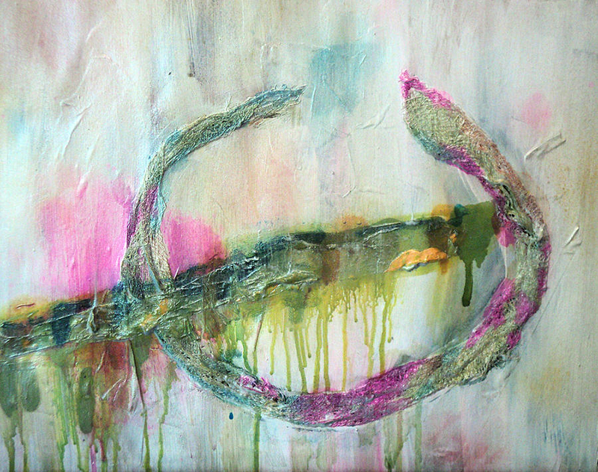

Fellowship
Thank you, Lauren for leading Fellowship
Please feel welcome to linger or pop a message in the chat and head off when you are ready.​
Extra resources developed
by Roots on the Web
Images from Padlet
Broken Promises – Shelli Finch
Roots on the Web
Notes:
Please ensure high level of contrast for the fellowship text block to make it easier for people to read

